Slide 1
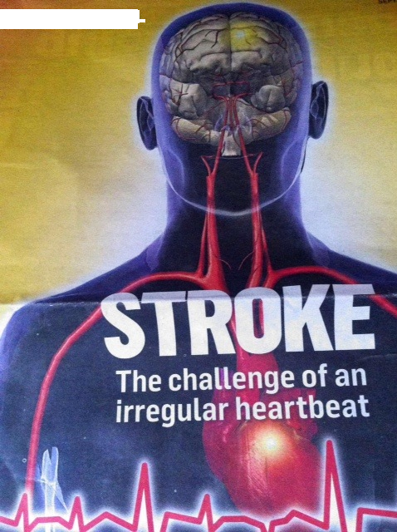
New Oral Anticoagulants
– the “Who, What, When & How”
Dr. Farooq Faheem

Slide 2
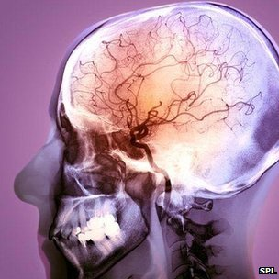
Importance of stroke prevention in NV-AF patients
✤ Overview of new treatments available
✤ Efficacy, clinical & safety data
✤ Treatment pathways and guidelines (BNSSG)
&
REAL LIFE CASES

Slide 3
Mr. M. R.
62 Years of age
Lives alone
Single

Slide 4
Past History
1998: Diabetes
2004 : Presented with ataxia confusion and headaches ? Cause
2007: Slurred speech and confusion : Put down to alcohol intoxification
August 2011: Slurred speech, facial drop AF and diagnosed with TIA/CVA and warfarinised

Slide 5
Background
Smokes 20 + cpd (mixture of tobacco and cigarettes)
Alcohol up to 2- 3 bottles of cider per day
Hypertension
Echocardiogram: Severe LV dysfunction & Biatrial dilatation
COPD with frequent exacerbations
Obesity with obstructive sleep apnea
                Dr. Farooq Faheem

Slide 6
Background
      Lives alone approx. 3 miles from the practice
      No transport
      Never married
      Not worked since 1998
      One sister in Weston 8 miles away

Slide 7
Progress
From Sept 2011 to February 2012: did very well with INR testing
20 x INR tests between March 12 to Aug 2012
Average INR 6.3 (Venous 8.9)
? Back to drinking heavily

Slide 8
Progress
Discussed at Partner’s meeting following complaints from District Nurses about his:
FEROCIOUS…………..

Slide 9
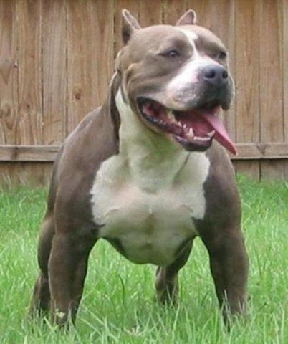
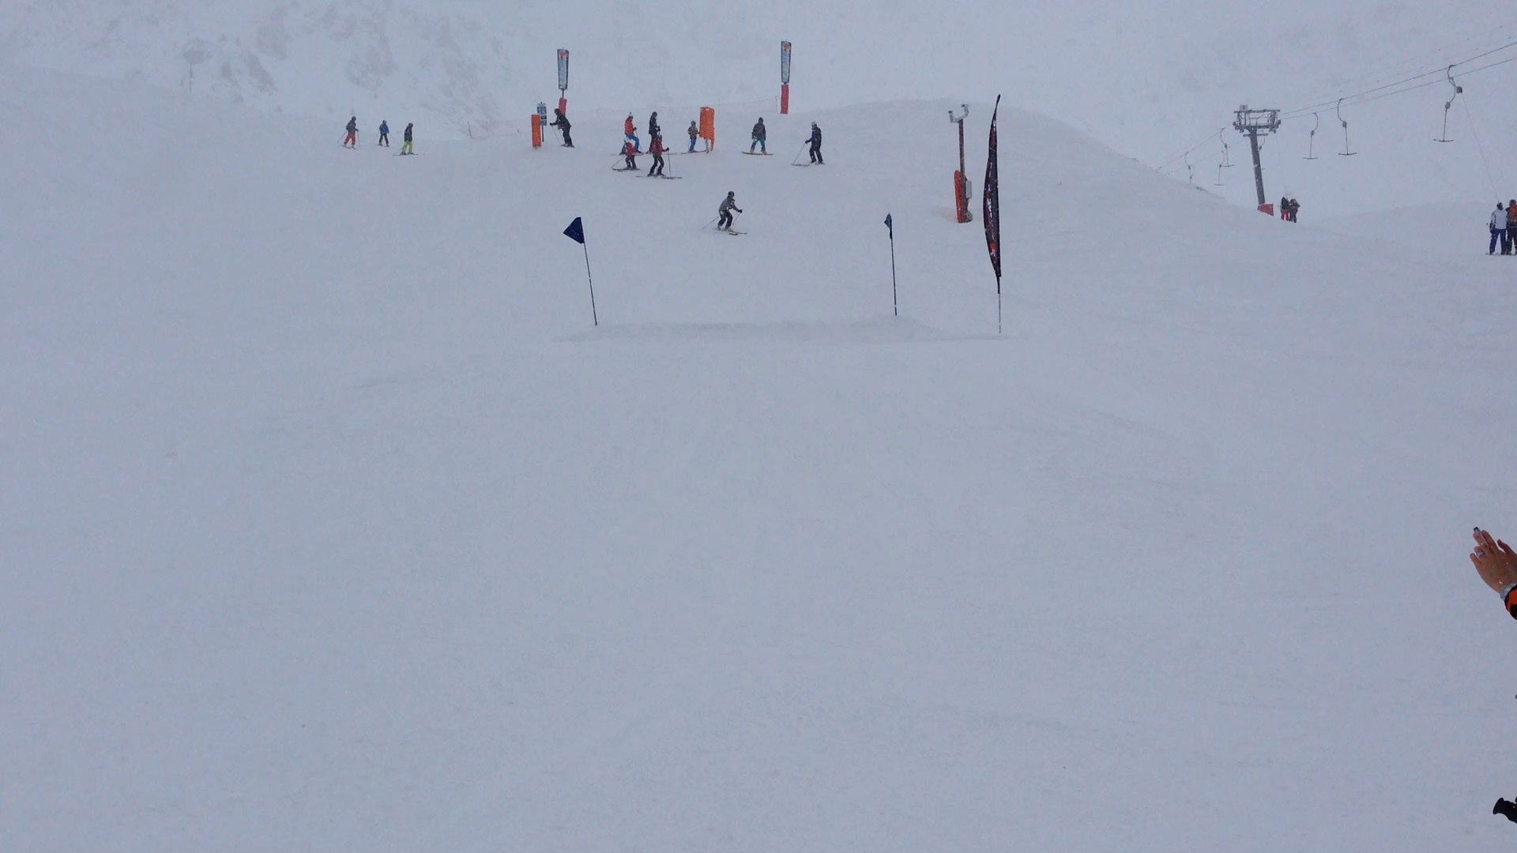
NO MORE EXCUSES

Slide 10
Discussions
Actual visits were twice as many according to District nurses
Would not wake up until late afternoon.
DN unable to get access to the house.
Substantial risk of falls

Slide 11
Started on NOAC November 2012
Added to his Dosette Box
Happy District Nurses!
Latest audit: No blood samples taken as unable to get access to his house

Slide 12
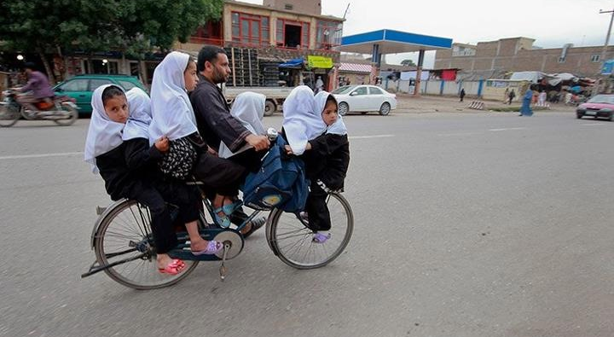
One has to do what one has to do!

Slide 13
Mrs. D.W.
82 Years of age
Lives alone

Slide 14
Background
Active extremely well and totally asymptomatic
Hypertension 2006. Ramipril was prescribed.
She never took it!
December 2010: near fainting and speech slurred and vacant for approx. 30 minutes
Declined admission, all medications including aspirin Put it down to worrying over Christmas period

Slide 15
Background
Never Smoked
Alcohol : One/Two units per Year!
Hypertension
Grows almost all of her vegetables. Extremely active
Large Family scattered around the UK and the world (Son in Canada, Daughter in France)
                Dr. Farooq Faheem

Slide 16
July 2012
      Presented with SOBOE
      She put it down to gaining a bit of weight
      All baseline bloods normal
      CXR: Normal

Slide 17
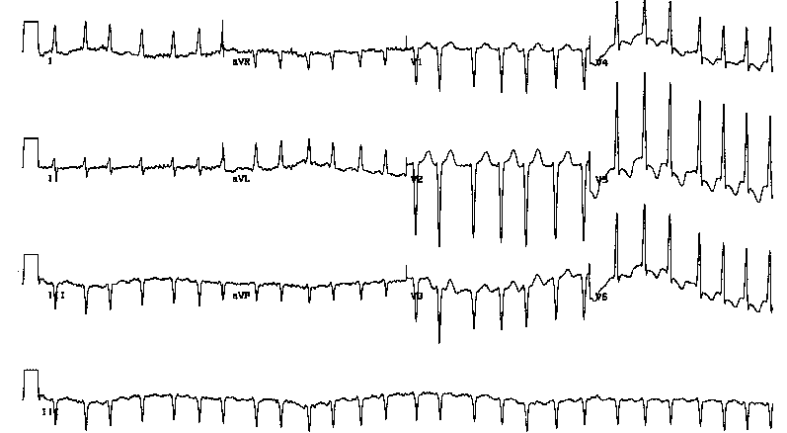
ECG

Slide 18
Progress
Explained: Very skeptical
Wanted to check herself : ON THE INTERNET!
To discuss with her family
Leaflet for warfarin and NOACs

Slide 19
Progress
Flatly refused to take warfarin
Most of her diet was from her home grown vegetables
Started on NOAC

Slide 20
One week later….

Slide 21
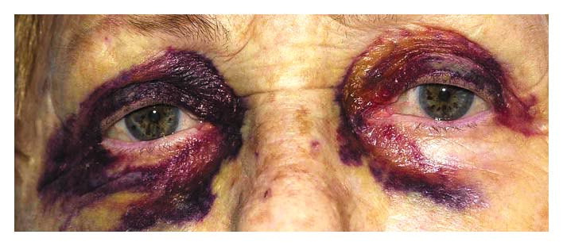

Slide 22
A Worried Doctor!
TOTALLY CHILLED PATIENT!
Asked her to stop medication and return a week later to discuss warfarin AGAIN!

Slide 23
No show…..
FOUR WEEKS LATER:
WANTED REPEAT PRESCRIPTION FOR…..

Slide 24
What happened?
PRESENTED TO EYE CASUALTY AT BRISTOL EYE HOSPITAL THE SAME EVENING…. as did not trust my advice!
OPHTALMOLOGIST REASSURED HER: MINOR BRUISING: No long-term consequences
THEY SUGGESTED SHE CONTINUES WITH NOAC

Slide 25
A VERY RELIEVED DOCTOR INDEED!

Slide 26
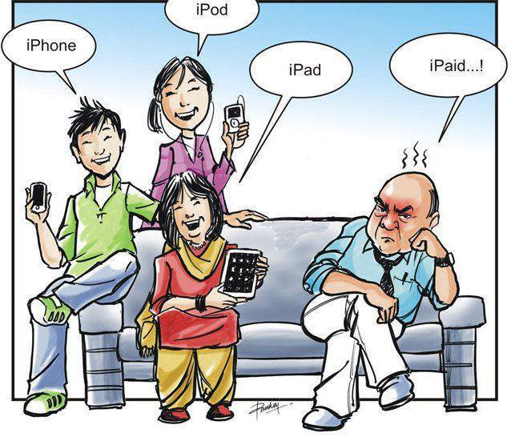

Slide 27
Patients with AF have an approximately fivefold increased risk of ischaemic stroke¹
Framingham Heart Study (N=5,070)
60
Risk ratio=4.8
p<0.001
50
40
2-year age-adjusted
incidence of stroke/1,000
30
*Patients were seldom treated with antithrombotic therapy when this study was performed in line with clinical practice at the time
20
10
0
Individuals
without AF
Individuals
with AF*
1. Adapted from Wolf PA et al. Stroke 1991;22:983–988
Notes:
Patients with AF have an approximately fivefold increased risk of ischaemic stroke
The Framingham Heart Study prospectively followed men and women who were free of cardiovascular disease (including AF) at study enrolment for every 2 years for the development of cardiovascular disease¹
A 34-year follow-up of this study, involving 5,070 participants, evaluated the impact of various cardiovascular conditions, including AF, on the incidence of stroke¹
In a comparison of the 2-year age-adjusted incidence of stroke per 1,000 individuals with and without AF, those with AF were almost five times more likely to suffer an ischaemic stroke than those without AF (p<0.001), 2-year age-adjusted incidence of stroke: ~50/1,000 individuals with AF vs ~10/1,000 individuals without AF)¹
References
Wolf PA et al. Stroke 1991;22:983–988

Slide 28
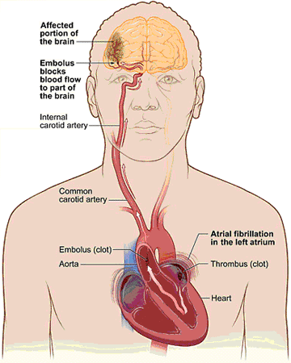
fine4fit.blogspot.com

Slide 29

ANIMATION

Slide 30
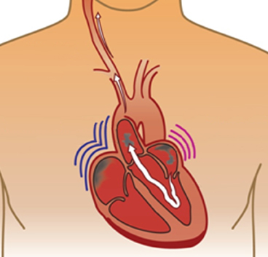
AF-related stroke can be preventable
By preventing thrombus formation in the heart (thrombo-prophylaxis)
Why Aspirin does not work?
Notes:
AF-related stroke is preventable
Ischaemic strokes in patients with AF can be prevented by thromboprophylaxis – i.e. inhibition of the formation of cardiogenic thrombi
Thromboprophylaxis can be achieved by using drugs that interfere with the coagulation pathway (anticoagulants) or that inhibit platelet aggregation (antiplatelet drugs)
Although anticoagulant and antiplatelet drugs are used for thromboprophylaxis in patients with AF, anticoagulation is more effective based on clinical trials data. ASA is recommended for thromboprophylaxis in patients at low risk of stroke^{1–3}
Both anticoagulant and antiplatelet therapy carry an increased risk of bleeding, which must be balanced against the need for thromboprophylaxis for each patient
Abbreviation
ASA, acetylsalicylic acid
References
Fuster V et al. Circulation 2006;114:700–752
Singer DE et al. Chest 2008;133:546S–592S
Camm J et al. Eur Heart J 2010;31:2369–2429

Slide 31
Many Factors Elevate AF Stroke Risk
CHADS₂ score
Annual Risk of Stroke
CHADS2 Score | Stroke Risk % | 95% CI
0 | 1.9 | 1.2–3.0
1 | 2.8 | 2.0–3.8
2 | 4.0 | 3.1–5.1
3 | 5.9 | 4.6–7.3
4 | 8.5 | 6.3–11.1
5 | 12.5 | 8.2–17.5
6 | 18.2 | 10.5–27.4
Risk factor | Points
Congestive heart failure/LV dysfunction | +1
Hypertension | +1
Age ≥75 years | +1
Diabetes mellitus | +1
Stroke/TIA/TE | +2
Cumulative score | Range 0−6
Score: 0 = low risk; 1 = intermediate risk; ≥2 = high risk
Gage Bet al. Circulation 2004; 110:2287-2292
Notes:
CHA₂DS₂-VASc is a newly proposed scheme that takes into account some of the risk factors (female gender and vascular disease) not included in CHADS₂²
In addition, this scheme takes into account that in reality age does not suddenly become a risk factor at age 75 years (1 point is awarded for age 65–74 years, 2 points are awarded for age ≥75 years) ²
Patients with a CHA₂DS₂-VASc score ≥2 (1 definitive risk factor [age≥75 or prior stroke/TIA] or 2 clinically relevant non-major risk factors) are considered to be at high risk of stroke and in need of anticoagulation²
Patients at intermediate risk, i.e. with a CHA₂DS₂-VASc score of 1 (1 clinically relevant non-major risk factor), may be managed with either ASA or OAC, although the latter is generally preferred
In contrast patients with a CHA₂DS₂-VASc score of 0 (no risk factors) may not require any form of antithrombotic therapy, thus simplifying the selection of patients for anticoagulation
Abbreviations
ASA, acetylsalicylic acid (aspirin); LV, left ventricular; MI, myocardial infarction; OAC, oral anticoagulation; PAD, peripheral artery disease; TE, thromboembolism; TIA, transient ischaemic attack
References
Gage Bet al. Circulation 2004; 110:2287-2292
Lip et al. Refining clinical risk stratification for predicting stroke and thromboembolism in atrial fibrillation using a novel risk factor based approach: The Euro Heart Survey on Atrial Fibrillation. Chest 2010;137:263–272.

Slide 32
The CHADS₂ index has been routinely used as an initial, rapid, and easy-to-remember means of assessing stroke risk^{1–4}
CHADS₂ | Adjusted stroke rate* (95% CI)
6 | 18.2 (10.5 to 27.4)
5 | 12.5 (8.2 to 17.5)
4 | 8.5 (6.3 to 11.1)
3 | 5.9 (4.6 to 7.3)
2 | 4.0 (3.1 to 5.1)
1 | 2.8 (2.0 to 3.8)
0 | 1.9 (1.2 to 3.0)
Patients (%)
36.1%
30.1%
27%
6.9%
CHADS₂ criteria | Score
Congestive HF | 1
Hypertension | 1
Age ≥75 years | 1
Diabetes | 1
Stroke or TIA (previous history) | 2
Sum
33.6% with CHADS₂
0 or 1
*Adjusted stroke rate = expected stroke rate per 100 patient-years
from exponential survival model, assuming ASA not taken
1. Gage et al. JAMA 2001;285:2864–2870
2. Gage et al. Circulation 2004;110:2287–2292
3. Camm et al. Eur Heart J 2010;31:2369–2429
4. Nieuwlaat et al. Eur Heart J 2006;27:3018–3026
Date of Preparation: October 2013. 432UK13PR10268-01. Not for further distribution.
32
Notes:
Abbreviations
CHADS₂: assigns one point each for congestive heart failure (C), high blood pressure (H), age 75 or older (A), and diabetes (D), and two points for a previous stroke (S2) or transient ischaemic attack
CI: Confidence interval
TIA: Transient ischaemic attack
References
Gage BF et al. Validation of clinical classification schemes for predicting stroke: results from the National Registry of Atrial Fibrillation. JAMA 2001;285:2864–70.
Gage BF et al. Selecting patients with atrial fibrillation for anticoagulation: stroke risk stratification in patients taking aspirin. Circulation 2004;110:2287–92.
Camm AJ et al. 2012 focused update of the ESC Guidelines for the management of atrial fibrillation: An update of the 2010 ESC Guidelines for the management of atrial fibrillation. Developed with the special contribution of the European Heart Rhythm Association. Eur Heart J 2012; Aug 24 [Epub ahead of print].
Nieuwlaat R et al; Euro Heart Survey Investigators. Antithrombotic treatment in real-life atrial fibrillation patients: a report from the Euro Heart Survey on Atrial Fibrillation. Eur Heart J 2006;27:3018–26.

Slide 33
The CHA₂DS₂-VASc scheme was adopted by the ESC to complement the CHADS₂ scoring system
CHADS₂ | Score | CHA₂DS₂-VASc | Score
Congestive heart failure | 1 | Congestive heart failure/left ventricular dysfunction | 1
Hypertension | 1 | Hypertension | 1
Aged ≥75 years | 1 | Aged ≥75 years | 2
Diabetes mellitus | 1 | Diabetes mellitus | 1
Stroke/TIA/TE | 2 | Stroke/TIA/TE | 2
Maximum score | 6 | Vascular disease (prior MI, PAD, or aortic plaque) | 1
 |  | Aged 65–74 years | 1
 |  | Sex category (i.e. female gender) | 1
 |  | Maximum score | 9
CHA₂DS₂-VASc:
In patients with a CHADS₂ score of 0–1, or
When a more detailed stroke risk assessment is indicated
Camm et al. Eur Heart J 2010;31:2369–429.
Notes:
Abbreviations
CHADS₂: assigns one point each for congestive heart failure (C), high blood pressure (H), age 75 or older (A), and diabetes (D), and two points for a previous stroke (S2) or transient ischaemic attack
CHA₂DS₂-VASc: Congestive heart failure, Hypertension, Age ≥75 (doubled), Diabetes, Stroke (doubled), Vascular disease, Age 65–74, and Sex category (female)
MI: Myocardial infarction; PAD: Peripheral arterial disease; TE: Thromboembolism
TIA: Transient ischaemic attack
References
Camm AJ et al. Guidelines for the management of atrial fibrillation: the Task Force for the Management of Atrial Fibrillation of the European Society of Cardiology (ESC). Eur Heart J 2010;31:2369–429. Erratum in: Eur Heart J 2011;32:1172.

Slide 34
CHA₂DS₂ - VASc Risk Scoring for AF patients and Thromboprophylaxis Guidelines (ESC)¹
Score | Risk | Considerations
0 | Low | Aspirin daily or no antithrombotic therapy No antithrombotic therapy preferred
1 | Moderate | Either; oral anticoagulant (e.g. well controlled warfarin or NOACs) or Aspirin daily
2 or more | Moderate / High | Oral anticoagulant (e.g. well controlled warfarin or NOACs)
Camm et al, 2010

Slide 35
The 2010/2012 ESC guidelines recommend the use of a simple bleeding risk score: HAS-BLED
Letter | Clinical characteristic | Points awarded
H | Hypertension | 1
A | Abnormal renal and liver function (1 point each) | 1 or 2
S | Stroke | 1
B | Bleeding | 1
L | Labile INRs | 1
E | Elderly (e.g. age >65 years) | 1
D | Drugs or alcohol (1 point each) | 1 or 2
 |  | Maximum 9 points
HAS-BLED ≥3:
Indicates ”high risk”, and
Some caution and regular review of the patient is needed following
the initiation of antithrombotic therapy, whether with OAC or aspirin
Notes:
Abbreviations
AF: Atrial fibrillation; ALT: alanine aminotransferase; AST: aspartate aminotransferase; BP: Blood pressure; ESC: European Society of Cardiology; HAS-BLED: Hypertension, Abnormal renal/liver function, Stroke, Bleeding history or predisposition, Labile INR, Elderly (>65), Drugs/alcohol concomitantly; INR: International Normalised Ratio; NSAIDs: Non-steroidal anti-inflammatory drugs; OAC: Oral anticoagulation; ULN: Upper limit of normal
References
Camm AJ et al. Guidelines for the management of atrial fibrillation: the Task Force for the Management of Atrial Fibrillation of the European Society of Cardiology (ESC). Eur Heart J 2010;31:2369–429. Erratum in: Eur Heart J 2011;32:1172.
Camm AJ et al. 2012 focused update of the ESC Guidelines for the management of atrial fibrillation: An update of the 2010 ESC Guidelines for the management of atrial fibrillation. Eur Heart J 2012;e-published August 2012, doi:10.1093/eurheartj/ehs253
Pisters R et al. A novel user-friendly score (HAS-BLED) to assess 1-year risk of major bleeding in patients with atrial fibrillation: the Euro Heart Survey. Chest 2010;138:1093–100.

Slide 36
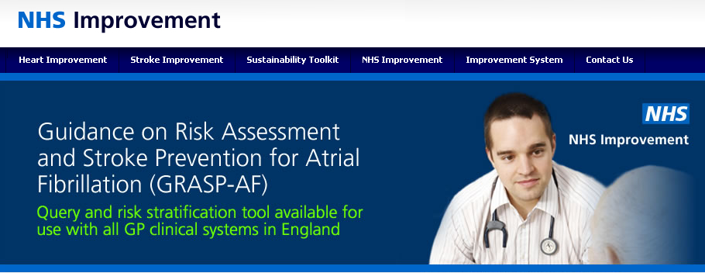
CHADS₂ and CHA₂DS₂-VASc both available in GRASP-AF
Risk factor | Points
Congestive heart failure/LV dysfunction | +1
Hypertension | +1
Age ≥75 years | +2
Diabetes mellitus | +1
Stroke/TIA/TE | +2
Vascular disease (MI, aortic plaque, PAD)* | +1
Age 65–74 years | +1
Sex category (female) | +1
Cumulative score | Range 0−9
http://www.improvement.nhs.uk/graspaf/- accessed 07/09/2012

Slide 37
ESC 2012 recommendations – risk assessment
Recommendations | Class | Level
The CHA₂DS₂-VASc score is recommended as a means of assessing stroke risk in non-valvular AF. | I | A
Assessment of the risk of bleeding is recommended when prescribing antithrombotic therapy (whether with VKA, NOAC, ASA/clopidogrel, or ASA). | I | A
The HAS-BLED score should be considered as a calculation to assess bleeding risk, whereby a score ≥3 indicates ‘high risk’. | IIa | A
Camm et al. Eur Heart J 2012;e-published August 2012, doi:10.1093/eurheartj/ehs253.
Notes:
Abbreviations
AF: Atrial Fibrillation
ASA: Acetyl salicylic acid
CHA₂DS₂-VASc: Congestive heart failure, Hypertension, Age ≥75 (doubled), Diabetes, Stroke (doubled), Vascular disease, Age 65–74, and Sex category (female)
ESC: European Society of Cardiology
HAS-BLED: Hypertension, Abnormal renal/liver function, Stroke, Bleeding history or predisposition, Labile INR, Elderly (>65), Drugs/alcohol concomitantly; INR: International Normalised Ratio
NOAC: Novel oral anticoagulants
VKA: Vitamin K antagonists
References
Camm AJ et al. 2012 focused update of the ESC Guidelines for the management of atrial fibrillation: An update of the 2010 ESC Guidelines for the management of atrial fibrillation. Eur Heart J 2012;e-published August 2012, doi:10.1093/eurheartj/ehs253.

Slide 38
ESC 2012 recommendations – antithrombotic therapy
Recommendations | Class | Level
Antithrombotic therapy to prevent thromboembolism is recommended for all patients with AF, except in those patients (both male and female) who are at low risk (aged <65 years and lone AF), or with contraindications. | I | A
The choice of antithrombotic therapy should be based upon the absolute risks of stroke / thromboembolism and bleeding and the net clinical benefit for a given patient. | I | A
When patients refuse the use of any OAC (whether VKAs or NOACs), antiplatelet therapy should be considered, using combination therapy with aspirin 75–100 mg plus clopidogrel 75 mg daily (where there is a low risk of bleeding) or – less effectively – aspirin 75–325 mg daily. | IIa | B
Camm et al. Eur Heart J 2012;e-published August 2012, doi:10.1093/eurheartj/ehs253.
Notes:
Abbreviations
AF: Atrial Fibrillation
ESC: European Society of Cardiology
NOAC: Novel oral anticoagulants
OAC: Oral anticoagulation
VKA: Vitamin K antagonists
References
Camm AJ et al. 2012 focused update of the ESC Guidelines for the management of atrial fibrillation: An update of the 2010 ESC Guidelines for the management of atrial fibrillation. Eur Heart J 2012;e-published August 2012, doi:10.1093/eurheartj/ehs253.

Slide 39
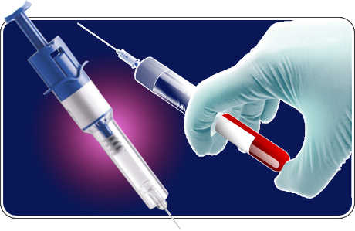
Traditional anticoagulants: drawbacks
UFH¹
  Parenteral administration
  Monitoring and dose adjustment required
  Risk of HIT
LMWH¹
  Parenteral administration
  Weight-adjusted dosing (for obese patients
Oral VKAs²
  Narrow therapeutic window
  Interaction with food and drugs
  Frequent monitoring and
  dose adjustment required
1. Hirsh J et al. Chest 2008;133;141S–159S
2. Ansell J et al. Chest 2008;133;160S–198S
Hirsh J et al. Chest 2008;133;141S–159S; 2. Ansell J et al. Chest 2008;133;160S–198S
Notes:
Traditional anticoagulants: drawbacks
This slide describes some of the drawbacks associated with traditional anticoagulants:
UFH is administered parentally, and the ACCP guidelines recommend monitoring and dose adjustment because the response varies among individuals. UFH is associated with a risk of HIT¹
LMWHs are also administered parenterally. ¹
Oral VKAs are challenging to use in clinical practice because they have a narrow therapeutic window, variable dose response and multiple food–drug and drug–drug interactions. As a consequence, frequent monitoring and dose adjustment is required to maintain the anticoagulation level within the therapeutic range²
Abbreviations
ACCP, American College of Chest Physicians; HIT, heparin-induced thrombocytopenia
References
1. Hirsh J et al. Chest 2008;133;141S–159S
2. Ansell J et al. Chest 2008;133;160S–198S

Slide 40
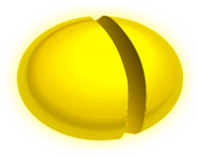
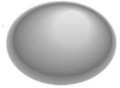











Coagulation pathway
VKA
TF
VIIa
VII
VKA
Initiation
X
IX
Propagation
VKA
Xa
Inactive Factor
IXa
Active Factor
Direct Factor Xa inhibition
Rivaroxaban
II
Prothrombin
Transformation
Catalysis
Direct Factor IIa inhibition
Dabigatran
IIa
Thrombin
Fibrinogen
Fibrin
Spyropoulos AC et al. Expert Opin Investig Drugs 2007;16:431–440 (adapted from)
Notes:
Targets for anticoagulants
This slide shows a simplified model of the coagulation pathway
Different anticoagulants target different points in the coagulation pathway
Factor Xa inhibitors
Factor Xa is an attractive target for anticoagulation because it plays a key role in the coagulation process and no thrombin can be generated without Factor Xa
Several direct Factor Xa inhibitors are either licensed or in development. These include rivaroxaban, apixaban, edoxaban and betrixaban¹
Direct thrombin inhibitors
Thrombin converts fibrinogen to fibrin and plays a key role in clot formation. It is also a potent activator of platelets
Direct thrombin inhibitors are able to inhibit free and clot-bound thrombin² and block the final step of the coagulation cascade
The direct thrombin inhibitor ximelagatran (withdrawn from the market owing to concerns of severe liver toxicity during long-term use²) provided proof-of-principle for new oral anticoagulants without routine coagulation monitoring
Dabigatran is the only drug in this class to be available for clinical use for the prevention of thrombosis in hip and knee surgery and the prevention of stroke and systemic embolism in patients with AF³
VKAs
VKAs, such as warfarin, target multiple coagulation factors by inhibiting vitamin K-dependent carboxylation of Factors II, VII, IX and X, leading to reduced coagulant activity
Abbreviation
TF, tissue factor
References
Spyropoulos AC et al. Expert Opin Investig Drugs 2007;16:431–440

Slide 41
Oral anti-coagulation is shown to be effective for stroke prevention in AF
Reduction of risk of thromboembolism in AF¹
Study, year
Relative risk reduction (95% CI)
Absolute risk reduction
AFASAK I, 1989; 1990
2.6%
4.7%
2.4%
1.2%
3.3%
8.4%
SPAF I, 1991
BAATAF, 1991
CAFA, 1991
SPINAF, 1992
EAFT, 1993
All trials (n=6)
primary prevention 2.7, secondary prevention 8.4
100%
50%
0
–50%
–100%
Favours VKA
Favours placebo
Hart RG et al. Ann Intern Med 2007;146:857–867
Notes:
Stroke prevention in AF: VKAs vs placebo or no treatment
Hart and colleagues performed a meta-analysis of clinical trials (n=6) that compared adjusted-dose warfarin with placebo
Warfarin reduced the relative risk of stroke by 64% (95% CI 49–74), compared with placebo
The absolute risk reduction for primary prevention was 2.7% and for secondary prevention was 8.4%
Abbreviations
BAATAF, Boston Area Anticoagulation Trial for Atrial Fibrillation; CAFA, Canadian Atrial
Fibrillation Anticoagulation; SPINAF, Stroke Prevention in Nonrheumatic Atrial Fibrillation
Reference
Hart RG et al. Ann Intern Med 2007;146:857–867

Slide 42

Limitations of Warfarin Therapy in AF
Unpredictable response
Slow onset/offset
of action
Warfarin therapy has several limitations that make it difficult to use in practice
Narrow therapeutic window
(INR range 2-3)
Numerous food-drug interactions
Need for coagulation monitoring
Numerous drug-drug interactions
Frequent dose adjustments
Risk of bleeding
complications
Established approaches for urgent reversal
Warfarin was #1 in 2003 and 2004 in the number of mentions of “deaths for drugs causing
adverse effects in therapeutic use”
Notes:
J Thromb Thrombolysis 2008; 25: 52-60.

Slide 43
Narrow Therapeutic Window
Target INR
(2.0-3.0)
Ischaemic stroke
Intracranial haemorrhage
80
The therapeutic effect of vitamin K antagonists is optimized when the INR is maintained within a narrow range
60
Events / 1000 patient years
40
20
0
<1.5
1.5–1.9
2.0–2.5
2.6–3.0
3.1–3.5
3.6-4.0
4.1-4.5
>4.5
International Normalised Ratio (INR)
N Engl J Med 2003; 349: 1019-26

Slide 44
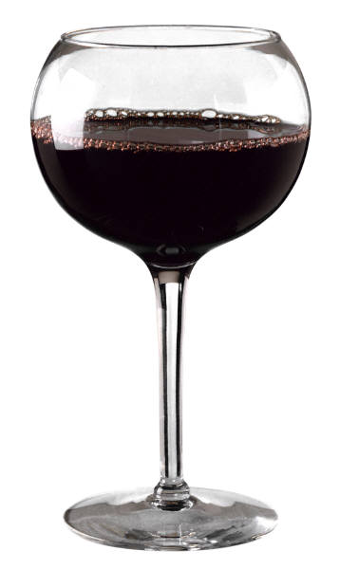


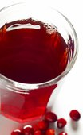
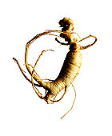
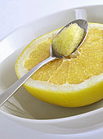
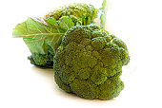
Drug and food interactions with warfarin

Slide 45
Reasons for warfarin omission
Bleeding
Risk
(23.5%)
Physician
Judgement
(50.4%)
Patient
Preference
(26.1%)
“Not Willing To Take VKA”
Another 22.8% “Not Willing
To Take VKA”
N Engl J Med 2009; 360: 2066-78

Slide 46
Ideal Anticoagulant?
 | Once daily | No Food Interactions | Predictable response | No routine coagulation monitoring | Fixed dosing | Wide therapeutic window | Easily Adaptable for compliance aids
OPTIMAL¹ | ✓ | ✓ | ✓ | ✓ | ✓ | ✓ | ✓
Warfarin^{1,2} | ✓
NOACs | +/- | ✓ Taken with food | ✓ | ✓ | ✓ | ✓ | ✓
Perzborn et al. Drug discovery 2011 10:65-71
Warfarin 0.5 mg SMPC 2010
Xarelto SmPC June 2012
Notes:
Optimal properties of an oral anticoagulant
An oral anticoagulant would optimally have once-daily administration, no significant food or drug interactions, and have a predictable dose response – which would permit use without routine coagulation monitoring, the use of a fixed dose and a wide therapeutic window
Warfarin requires frequent monitoring and dose adjustments, and interacts with numerous foods and drugs
Dabigatran requires twice-daily dosing⁴
References
Perzborn et al. Drug discovery 2011 10:65-71
Warfarin 0.5 mg SMPC 2010
Xarelto 15mg and 20mg SmPC June 2012
Dabigatran SMPC 2011

Slide 47
SPAF trials versus warfarin
 | Dabigatran¹⁻³ | Rivaroxaban^{4,5} | Apixaban^{6,7}
Study | RE-LY | ROCKET-AF | ARISTOTLE
Design | PROBE | Double Blind | Double Blind
Follow up | 2 yrs | 1.5 yrs | 1.5 yrs
Population size | >18,000 | >14,000 | >18,000
Inclusion | Nonvalvular AF + 1 risk factor | Nonvalvular AF + 2 risk factors (i.e. moderate to high risk) | Nonvalvular AF + 1 risk factor
Inclusion (CHADS) | 2.1 | 3.5 | 2.1
Primary Endpoint | Stroke and systemic embolism | Stroke and systemic embolism | Stroke and systemic embolism
Warfarin comparator INR control (mean TTR) | 64% | 55% | 62%
PROBE = prospective randomised open blinded end-point; INR = international normalised ratio; TTR = time in therapeutic range
Clinical Trial Data for information only - no clinical conclusions should be drawn. Please refer to individual product SPCs for further information.
1. Ezekowitz MD et al. Am Heart J 2009;157:805–10; 2. Connolly SJ et al. N Engl J Med 2009;361:1139–51; 3. Connolly SJ et al. N Engl J Med 2010;363:1875–1876; 4. Rocket Investigators. Am Heart J 2010;159:340-347; 5. Patel MR et al. NEJM 2011;365:883–91; 6. Lopes et al. Am Heart J 2010;159:331-9; 7. Granger et al. N Eng J Med 2011;365:981-92.

Slide 48
New agents: Stroke, systemic embolism vs warfarin
SSE vs warfarin (ITT population) | %/yr | Warfarin %/yr | HR (95% CI)
Dabigatran 150 mg | 1.11 | 1.71 | 0.65 (0.52-0.81)
Dabigatran 110 mg | 1.54 | 1.71 | 0.90 (0.74-1.10)
Rivaroxaban | 2.1 | 2.4 | 0.88 (0.75-1.03)
Apixaban | 1.27 | 1.60 | 0.79 (0.66-0.95)
SSE = stroke and systemic embolism
0.5
1
1.5
Favours new orals Favours warfarin
Clinical Trial Data for information only - no clinical conclusions should be drawn. Please refer to individual product SPCs for further information.
1. Connolly SJ et al. N Engl J Med 2009;361:1139–51; 2. Connolly SJ et al. N Engl J Med 2010;363:1875–1876; 3. Patel MR et al. NEJM 2011;365:883–91 and Supplementary Appendix;
4. Granger et al. N Eng J Med 2011;365:981-92.

Slide 49
New agents: Ischaemic stroke vs warfarin
Ischaemic stroke vs warfarin | %/yr | Warfarin %/yr | HR (95% CI)
Dabigatran 150 mg | 0.86 | 1.14 | 0.75 (0.58-0.97)
Dabigatran 110 mg | 1.28 | 1.14 | 1.13 (0.89-1.42)
Rivaroxaban | 1.34 | 1.42 | 0.94 (0.75-1.17)
Apixaban* | 0.97 | 1.05 | 0.92 (0.74-1.13)
*Ischaemic or uncertain type of stroke
0.5
1
1.5
Favours new orals Favours warfarin
Clinical Trial Data for information only - no clinical conclusions should be drawn. Please refer to individual product SPCs for further information.
1. Connolly SJ et al. N Engl J Med 2009;361:1139–51; 2. Connolly SJ et al. N Engl J Med 2010;363:1875–1876; 3. Patel MR et al. NEJM 2011;365:883–91 and Supplementary Appendix;
4. Granger et al. N Eng J Med 2011;365:981-92.

Slide 50
New agents: Haemorrhagic stroke vs warfarin
Haemorrhagic stroke vs warfarin | %/yr | Warfarin %/yr | HR (95% CI)
Dabigatran 150 mg | 0.10 | 0.38 | 0.26 (0.14-0.49)
Dabigatran 110 mg | 0.12 | 0.38 | 0.31 (0.17-0.56)
Rivaroxaban | 0.26 | 0.44 | 0.59 (0.37-0.93)
Apixaban | 0.24 | 0.47 | 0.51 (0.35-0.75)
0
1
2.0
Favours new orals Favours warfarin
1. Connolly SJ et al. N Engl J Med 2009;361:1139–51; 2. Connolly SJ et al. N Engl J Med 2010;363:1875–1876; 3. Patel MR et al. NEJM 2011;365:883–91 and Supplementary Appendix;
4. Granger et al. N Eng J Med 2011;365:981-92.

Slide 51
New agents: Intracranial bleeding vs warfarin
Intracranial bleeding vs warfarin | %/yr | Warfarin %/yr | HR (95% CI)
Dabigatran 150 mg | 0.32 | 0.76 | 0.41 (0.28-0.60)
Dabigatran 110 mg | 0.23 | 0.76 | 0.30 (0.19-0.45)
Rivaroxaban | 0.5 | 0.7 | 0.67 (0.47-0.93)
Apixaban | 0.33 | 0.80 | 0.42 (0.30-0.58)
0
1
2.0
Favours new orals Favours warfarin
Clinical Trial Data for information only - no clinical conclusions should be drawn. Please refer to individual product SPCs for further information.
1. Connolly SJ et al. N Engl J Med 2009;361:1139–51; 2. Connolly SJ et al. N Engl J Med 2010;363:1875–1876; 3. Patel MR et al. NEJM 2011;365:883–91 and Supplementary Appendix;
4. Granger et al. N Eng J Med 2011;365:981-92.

Slide 52
Clinical pharmacology
 | Apixaban¹ | Rivaroxaban² 15 & 20mg | DabigatranDabigatran³
Mechanism of action | Direct factor Xa inhibitor | Direct factor Xa inhibitor | Direct thrombin inhibitor
Oral bioavailability | ~50% | 80–100% with food | ~6.5%
Pro-drug | No | No | Yes
Food effect on bioavailability | No | Yes (20 mg and 15 mg doses taken with food) | No
Renal clearance | ~27% | ~33 % * | 85%
Dialysis | Not recommended | Not dialysable | Dialysable
Mean half-life (t_{1/2}) | ~12 h | 11-13 h in elderly 5-9 h in younger pts | 12–14 h
T_{max} | 3–4 h | 2–4 h | 0.5–2 h
direct renal excretion as unchanged active substance
No head-to-head clinical trial comparisons between apixaban, rivaroxaban and dabigatran have been performed. The information in this table is based on the SmPCs for apixaban, rivaroxaban and dabigatran. Please refer to the relevant SmPCs for further information
1. Apixaban SmPC, September 2013 Available at: http://www.medicines.org.uk/emc/medicine/24988. Date accessed: October 2013. 2. Rivaroxaban SmPC, February 2013. Available at: http://www.medicines.org.uk/emc/medicine/24988. Date accessed: April 2013. 3. Dabigatran Etexilate SmPC, February 2013. Available at: http://www.medicines.org.uk/emc/medicine/20760. Date accessed: April 2013.
52

Slide 53
  In the ARISTOTLE trial, for every 1000 NVAF patients treated for 1.8 years, apixaban as compared with warfarin prevented:
6
strokes
15
major bleeds
8
deaths
Prespecified hierarchical sequential testing was performed first on stroke/systemic embolism (primary efficacy endpoint) for non-inferiority, then for superiority, then on major bleeding, and finally on death from any cause (secondary endpoint).
Granger et al. N Engl J Med 2011;365:981–92.
Notes:
Abbreviations
AF: Atrial fibrillation
References
Granger CB et al; ARISTOTLE Committees and Investigators. Apixaban versus warfarin in patients with atrial fibrillation. N Engl J Med 2011;365:981–92.

Slide 54
Local and National Guidance

Slide 55
BNSSG guidance on anticoagulation in AF

Slide 56
http://www.bnssgformulary.nhs.uk/Local-Guidelines/

Slide 57
ESC 2012 recommendations – choice of anticoagulant
Non-valvular AF
Valvular AF*
Yes
<65 years & lone AF (including female)
No
Assess risk of stroke (CHA₂DS₂-VASc score)
VKA
*Includes rheumatic
valvular disease and
prosthetic valves
0
1
≥2
OAC therapy
(apixaban is not recommended
for patients with prosthetic heart valves )
Assess bleeding risk (HAS-BLED score)
Consider patient values and preferences
No antithrombotic
therapy
NOAC**
VKA
**NOACs are broadly preferable to VKA in the vast majority of patients with NVAF
For full recommendations please refer to the ESC Guidelines for the management of atrial fibrillation (2012 update)¹
AF: atrial fibrillation; ASA: acetyl salicylic acid; CHA₂DS₂-VASc: Congestive heart failure, Hypertension, Age ≥75 (doubled), Diabetes, Stroke (doubled), Vascular disease, Age 65–74, and Sex category (female); HAS-BLED: Hypertension, Abnormal renal/liver function, Stroke, Bleeding history or predisposition, Labile INR, Elderly (>65), Drugs/alcohol concomitantly; INR: International Normalised Ratio; NOAC: novel oral anticoagulants; NVAF: non-valvular atrial fibrillation; OAC: oral anticoagulant;
VKA: vitamin K antagonists
Adapted from Camm et al. Eur Heart J 2012;33:2719-47

Slide 58
NOACS for stroke and systemic embolism in non-valvular AF

Slide 59
Practical Issues: What do I do in my every day practice?

Slide 60
YVMP
Audit of Patients on Rivaroxaban
JULY 2012 To July 2013

Slide 61
Before Treatment
Full discussion of CHA2DS2Vasc risks
Leaflets on Warfarin and NOACs
Risks and benefits of ALL drug group explained

Slide 62
Before Treatment
      FBC, ELEC LFTs and Clotting screen
      Patient sent home to read the leaflets and decide
      &
      Ask Dr. Google if he/she or family wished
      Full documentation in medical records

Slide 63
After treatment started
Repeat FBC Creatinin eGFR, LFTs between 6-12 weeks
Fill in Patient alert card with the prescription
Ask to treat the medications as if on warfarin
Compliance stressed

Slide 64
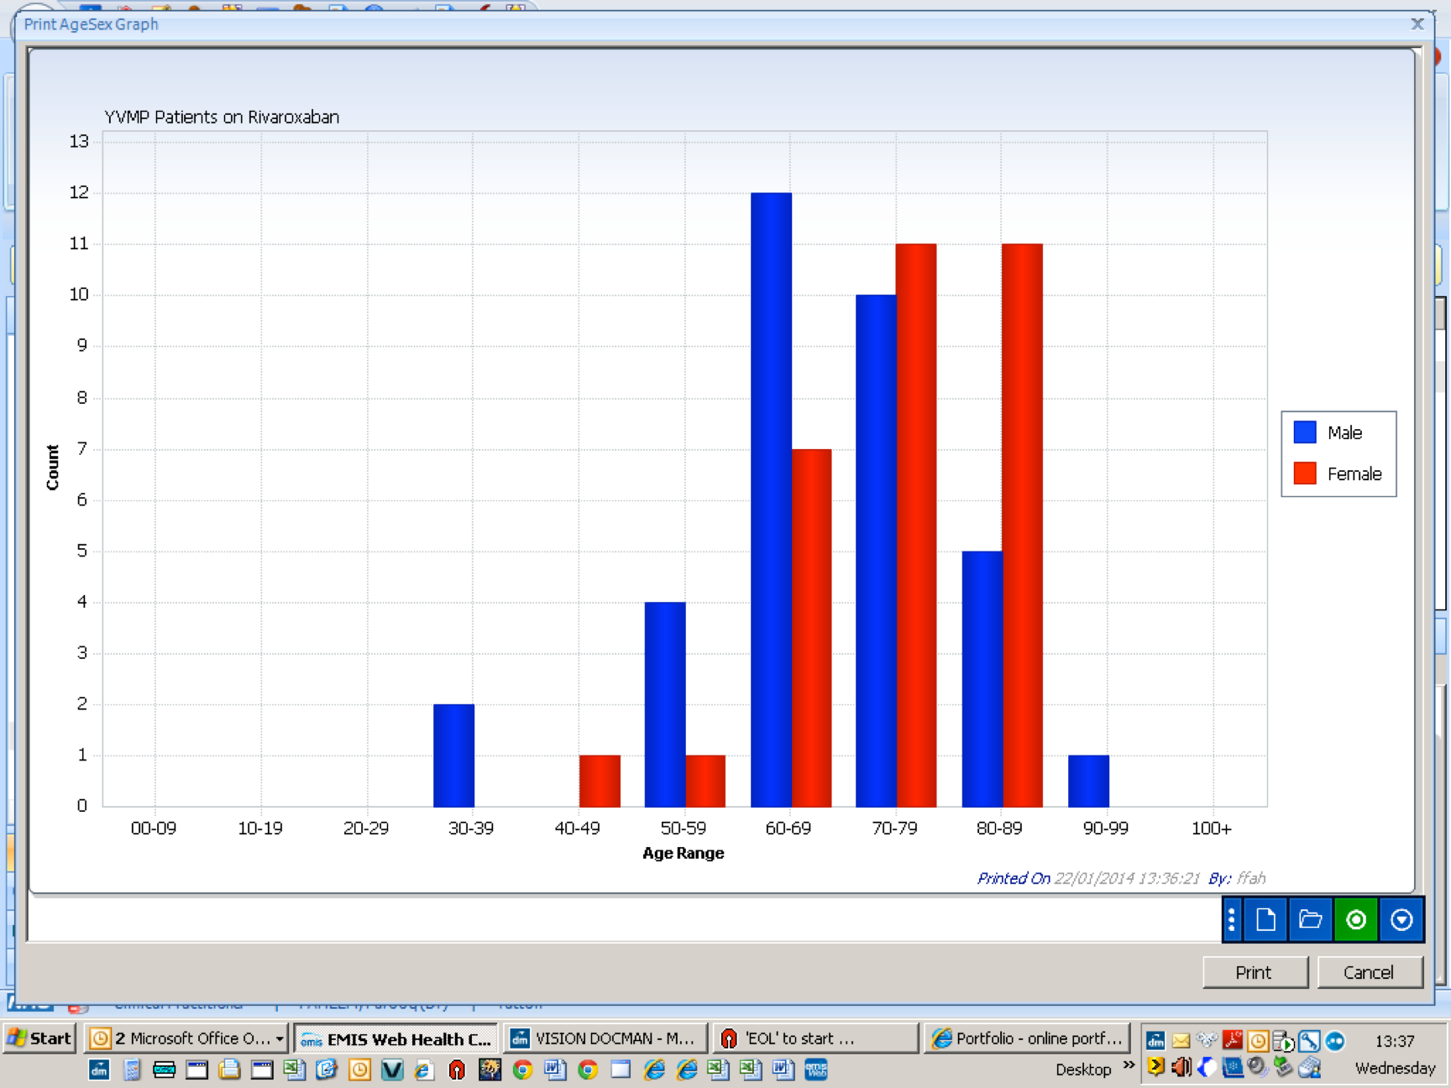

Slide 65
Up to 31st July 2013
Total of 41 Patients
18 Female and 23 Male
Age range 52- 89
3 DVT and 38 AF patients
Four transfer from Warfarin 1 From Dabigatran
One patient stopped so far because ? Pruritis

Slide 66
Follow up
Two dose reduction: one eGFR drop and one Chemo affecting renal function
Two no Post NOACs blood.
1 Change from Warfarin b/c of lifestyle: travelling a lot
NO significant Hb or eGFR change otherwise

Slide 67
When give the choice:
All patients have chosen NOACs
Novel instead of Old
The difference?

Slide 68
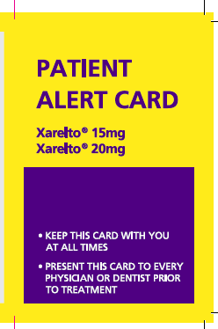
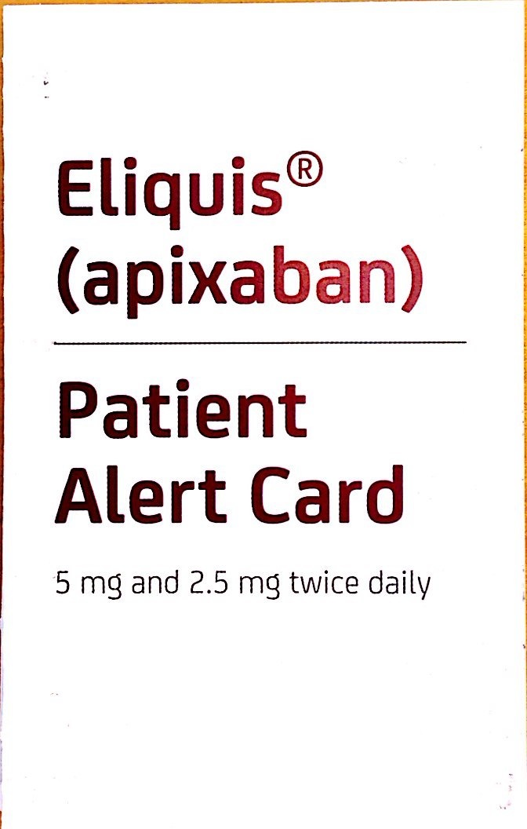
Absolutely Crucial

Slide 69
How can you support your local clinicians?

Slide 70
ANY QUESTIONS?

