Slide 1
Going live with EPS 26th March 2014
Supporting Community Pharmacy across Avon

Slide 2
Meet Bob
Patient nominations?
Computer system?
End of month process?
What are tokens?
Smart card issues?
What is the spine goes down?

Slide 3
Bob makes a plan
Attend LPC training event
Spend time speaking to people already live
Speak to local GP practice to see how they are approaching EPS
Make sure printer is up to the job
Process a test script before go live to check connections
Request enough tokens
Sort out smart cards for team

Slide 4
Bob start to get moving
Smart cards
Filling in all the forms
Sorting out smart cards for team
If appropriate becoming a sponsor
Tokens
Ordering tokens from NHS Stores
Same place as FP57s etc
Phone / fax
Order takes about 2-3 days to arrive
Contains ~2,000 tokens
Make sure you have spares

Slide 5
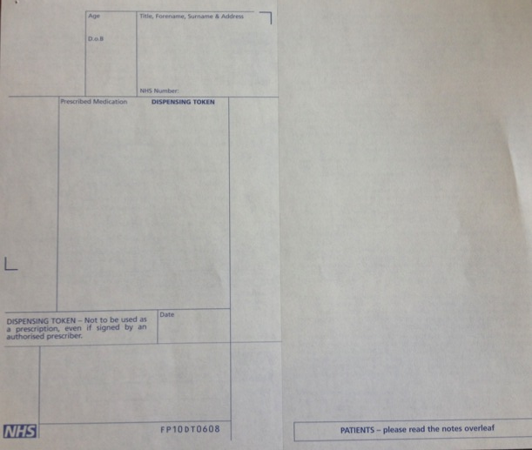
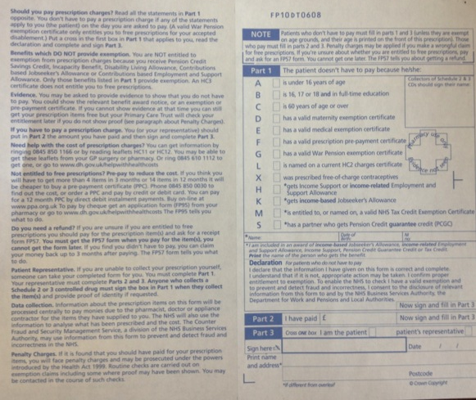
Bob is really motoring now

Slide 6
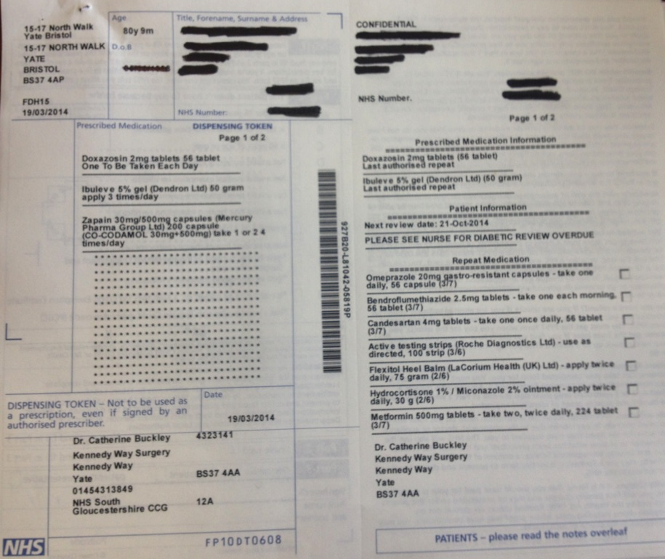
Bob and tokens

Slide 7
Bob works out how to dispense
Print token
Good idea to make certain your system either automatically contacts the spine regularly or you do it manually
Scan barcode
Adjust any problems on the labels (in particular directions)
Print dispensing labels
Dispense and check as normal
Use back of script to enable patient to sign exemption if >16 and <60
Keep repeat slip or give back to patient

Slide 8
Bob has this sorted
End of day process
Mark exemptions on the patient electronic record before the script goes to the PPA.
No exemption = lose money
Once someone has picked up the script, mark script as being collected by patient and then set them to go to the PPA
Sometimes further endorsing is required.
Once sent to the PPA it takes time and may require the system to be logged on to complete the whole transfer
Returned scripts may appear in an ‘outbox’
End of month process
Box to tick at the end of the month to claim £200
Tokens with signed exemption go in the end of month box, but don’t need to be organised at all.
Paid tokens don’t need to be sent

Slide 9
Bob is now EPS LIVE

Slide 10
Any questions for Bob?

Slide 11
Before go live
Concerns
What are tokens
What happens if the spine goes down
Smart cards
Getting people nominated
Nervous about computer system
End of month process
Before go Live
Printers
Amount of use
Amount of toner
Not ‘man’ enough for the job

Slide 12
Before go live
Test script to ensure system worked ok
See system live in another pharmacy
Speak to your local GP practices
End of day process
Mark exemptions on the patient electronic record before the script goes to the PPA. No exemption = lose money
Count them separately
Once someone has picked up the script
Mark script as being collected by patient and then mark them to go to the PPA
Sometimes further endorsing is required.
Once sent to the PPA it takes time and may require the system to be logged on to complete the whole transfer
Returned scripts may appear in an ‘outbox’
At the

Slide 13
End of month process (paper form)
Box to tick at the end of the month to claim £200
Tokens with signed exemption go in the end of month box, but don’t need to be organised at all.
Paid tokens don’t need to be sent

Slide 14
Getting smart cards for everyone
Waiting for passwords
Nominating people to have admin rights
Need a couple of colleagues who can reset passwords and have full admin role (they can also nominate)
How you get tokens
From NHS Stores (fax / phone request) same place as FP57s etc
Order boxes in advance
Take 2-3 days to turn up
~2,000 sheets / box
Use tokens for
Printing all scripts if you need them for the dispensing process
Patients to sign on the back if 16<x<60

Slide 15
Print token
Good idea to make certain your system either automatically contacts the spine regularly or you do it manually
Scan barcode
Adjust any problems on the labels (in particular directions)
Print dispensing labels
Dispense and check as normal
Use back of script to enable patient to sign exemption if >16 and <60
Need to print token to generate repeat slip for either the pharmacy or patient to manage

