Slide 1

Managing Wounds
Sally Irving- Independent Tissue Viability Nurse Consultant. sally@boocare.co.uk

Slide 2
Wound Aetiology
Acute
    Burns – dry heat, moist heat, chemical, radiation
    Lacerations
    Surgical incisions
Chronic
    Leg ulcers
    Pressure ulcers
    Fungating lesions

Slide 3
understanding the phases of wound healing

Slide 4

“Wound healing, or wound repair, is an intricate process in which the skin (or another organ-tissue) repairs itself after injury” (Nguyen, Orgill, Murphy 2009)

Slide 5
The Process
The Process
Once the protective barrier is broken, the normal physiological process of wound healing starts.
The classic model of wound healing is divided into overlapping phases (Stadelmann, Digenis, Tobin, 1998).

Slide 6
Wound Healing
Haemostasis
Inflammation
Destruction
Proliferation
Epithelialisation
Maturation

Slide 7
Of Wound Healing
Haemostasis:
A physiological response that starts after injury, following cell death and bleeding.
Vasoconstriction causes bleeding to stop.
Histamine mediators are released causing vasodilation of intact blood vessels.
- Clot serves to act as a bacterial barrier.
- Framework for migrating cells (Benbow 2005)

Slide 8
Of Wound Healing
Haemostasis: points to note
Not all wounds will follow this stage as it is dependent on the nature of the wound.
For example, chronic wounds such as pressure ulcers are caused by lack of blood supply to the tissues.
The lack of blood supply to the tissues results in tissue death and ischaemia.
Therefore this wound type would not go through Haemostasis

Slide 9
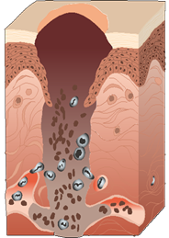
Inflammation Phase 0-5 days
Inflammation can be characterised by:
Pain
Heat
Swelling,
Erythema,
(Tortora & Derrickson,2011)
These signs of inflammation should not be confused with infection...
y:

Slide 10
Inflammation Phase 0-5 days
Neutrophils cleanse the area of bacteria and devitalised tissue.
This stimulates the release of various substances that cause dilation & increased permeability of blood vessels to the injured area & delivery of macrophages and polymorphs.
Macrophages produce a variety of substances that regulate healing by promoting the proliferation of fibroblasts and growth factors to stimulate angiogenesis.
Blood clot to the wound
Basal epithelial cells
Monocytes (macrophages)
End of blood clot
Damaged blood vessel

Slide 11
Destructive phase (1-6 days)
Clearance of dead devitalised tissue
Phagocytosis by polymorphs and macrophages
(decrease in activity with a fall in temperature)
Polymorphs engulf and destroy bacteria
Macrophages
        Destroy bacteria, remove devitalised tissue and fibrin
        Stimulate fibroblast formation
        Produce angiogenic stimulating factor
(Polymorph and macrophage activity inhibited by hypoxia, chemicals and build up of metabolic waste if tissue perfusion poor)

Slide 12
Inflammation Phase 0-5 days
Exudate is a normal by-product of the inflammatory phase.
Wound exudate is produced and in a healthy wound contains substances that are vital to wound healing.
Contains growth factors, nutrients, neutrophils, macrophages, lymphocytes, and proteases (Timmons, 2006).

Slide 13
Managing Wounds in Inflammation
Manage pain - The inflammatory stage is more painful.
Manage exudate - The exudate level is higher during inflammation
Protect the periwound skin.
Protect from invading bacteria.

Slide 14
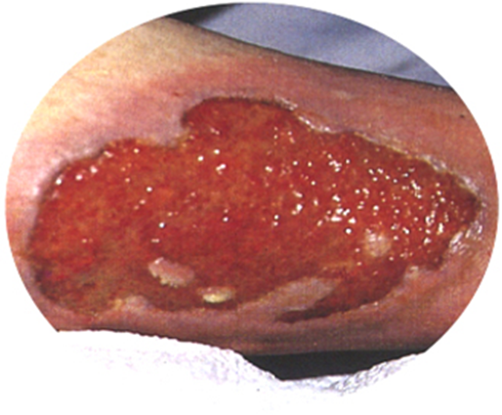
Proliferative Phase 3-14 days
Stage of healing in which active regeneration and construction of new tissue occurs.
Damaged blood vessels begin to re-grow. (Angiogenesis)
Extracellular Matrix (ECM) spreads over the entire surface of the wound
Extracellular Matrix (ECM) together with angiogenesis comprises the granulation tissue
(Tortora & Derrickson, 2011)
Fibroblasts migrate along the fibrin threads and begin synthesising scar tissue.

Slide 15
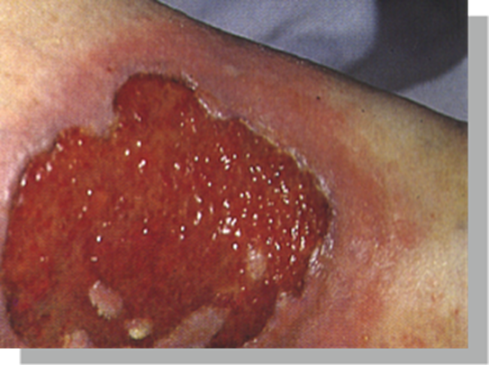
Proliferation Phase 3-14 days (cont’d)
Wound contraction, re-growth of epithelial cells takes place.
New epithelial cells migrate from the edges of the wound and also from within hair follicles, sebaceous glands and sweat glands.
The cells stop migrating once they meet other epithelial cells, this is known as contact inhibition.
(Timmons, 2006).

Slide 16
Maturation:
Maturation, also known as remodeling, is the last stage of the wound healing process. It occurs after the wound has closed up and can take as long as two years.
During this phase, the dermal tissues are overhauled to enhance their tensile strength and non-functional fibroblasts are replaced by functional ones.
While it may appear that the wound healing process is finished when maturation begins, it’s important to keep up the treatment plan. If the wound is neglected, there’s risk of it breaking down dramatically as it is not at its optimal strength.
Even after maturation, wound areas tend to remain up to 20% weaker than they initially were.

Slide 17
Holistic Assessment
Before considering the wound you must consider the whole patient:
Patients age - age related changes may impact on wound repair
Concomitant disease such as Diabetes, heart disease, arterial disease, auto immune and inflammatory disorders and cancers
Medication – some medication may impact on wound repair such as anti-inflammatory drugs and cytotoxics

Slide 18
Holistic Assessment con’t
Nutrition – is a key factor in wound healing and a healthy diet is essential as the demands for nutrients increases when tissue is repairing
Infection – there are two aspects of infection to be considered, infection in the wound and infection at another body sites which would increase the risk of wound infection and delayed wound repair
Psychosocial issues considering social isolation, the impact of the diagnosis and financial or work related issues
Pain – in the wound and elsewhere

Slide 19
Wound Assessment
Applied Wound Management
TIME/S
Wound Bed Preparation
Triangle of Wound Care
Completing wound assessment documentation / template is essential and take images of the wound

Slide 20
The Wound Bed
The wound measurement
The depth of the wound
Presence of sinus or fistula
Level and type of exudate
The appearance of the wound bed and the percentage of tissue type visible
  Necrosis – black or brown tissue
  Slough – yellow, grey, white tissue
  Granulation – red healthy tissue

Slide 21
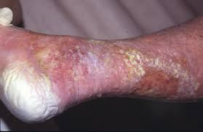
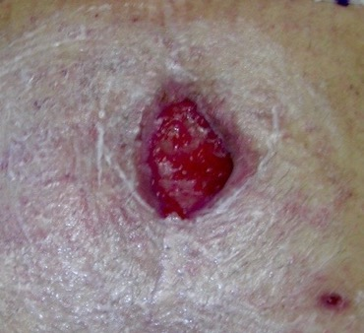
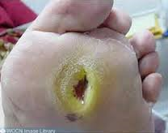
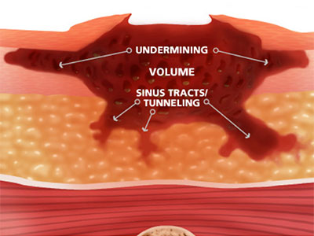
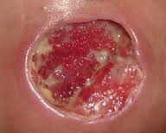
Wound Edge
Macerated
Dehydrated
Undermined
Rolled
Thickened

Slide 22
Periwound Skin
Maceration
Excoriation
Dry skin
Hyperkeratosis
Callus
Oedema
Perfusion
Inflammation
Eczema

Slide 23
Abnormal Wound Healing
Absence of granulation
Chronic inflammation
Over granulation
Failure of epithelialisation
Wound contamination, colonisation, infection

Slide 24
Factors Delaying Healing
Age
Concomitant disease
Medication
Nutrition
Infection
Anaemia
Psycho/social
Excess necrosis
Impaired drainage
Excess exudate
Repeated trauma
Presence of foreign body
Inappropriate treatment

Slide 25
Conclusion
It is essential in wound management that the clinician understands the process of wound repair, can accurately assess the patient and the wound and, as a result, can identify the aetiology so optimal wound management is provided.
Wounds sometimes fail to heal or become stalled.
If this is not recognised promptly then this can cause pain and distress for the patient and will increase the financial burden of managing the wound.

Slide 26
Types of Wound Healing

Slide 27
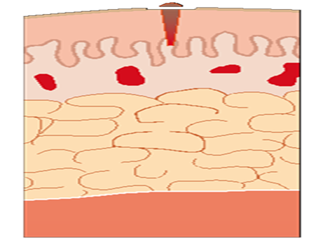
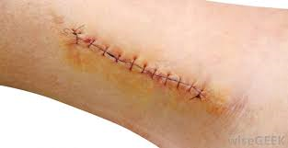
Primary Intention
Primary intention healing refers to a wound where the edges have been brought together by skin adhesives, sutures and staples (Gray et al, 2006).
Suture blood clot
on can be
Involves epidermis and dermis without total penetration of dermis healing by process of epithelialisation.
When wound edges are brought together so that they are adjacent to each other (re-approximated).
Wound closure is performed with sutures (stitches), staples, or adhesive tape.
Minimises scarring.
Most surgical wounds heal by primary intention.
Healing rapid.

Slide 28
Secondary Intention:
Healing by secondary intention occurs when damage has resulted in loss of tissue and where the skin edges cannot be brought together for wound closure (Benbow, 2005).
Chronic wounds such as pressure ulcers, leg ulcers and dehisced surgical wounds heal by secondary intention.
When an injury extends to tissue deep into the epidermis and dermis and the wound is not “closed”, the healing process takes longer due to the volume of connective tissue required to fill the deficit.

Slide 29
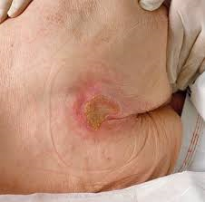
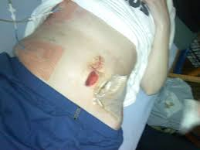
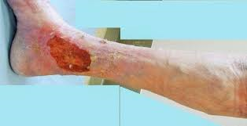
Secondary Intention:

Slide 30
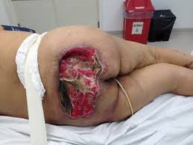
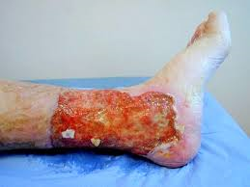
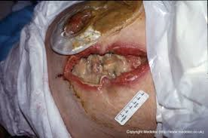
Secondary Intention:

Slide 31
Tertiary Intention
Healing by Tertiary intention are wounds that are managed with delayed primary closure.
Method used when there is considerable bacterial contamination.
Used in wounds complicated by oedema or excessive exudate production (Hess, 2011).
Three to five days later the wound is closed surgically and then it heals by primary intention (Dealey, 2005).

Slide 32
Dressing Selection

Slide 33
Dressing Selection:
To choose what is best
  Thorough patient assessment
  Thorough wound assessment
  Choose the most cost effective product, with the most appropriate characteristics (Morgan 1999)

Slide 34
What is an ideal dressing?
Maintains moist environment
Provides thermal insulation
Low or non adherent
Infrequent changing
Mechanical protection
Free from contaminants
Safe (non toxic, non sensitising, non allergenic)

Slide 35
Ideal Dressing:
Conformable and mouldable
Good absorption (exudating wounds)
Impermeable to micro-organisms
Acceptable to patient
Cost effective
Sterile – single use only
Available in suitable forms/sizes

Slide 36
Consider aim of treatment
This will depend on multiple factors
Wound bed assessment is key and will guide dressing selection

Slide 37
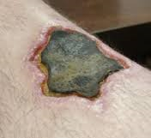
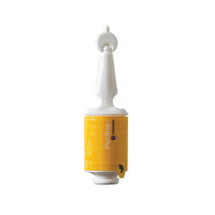
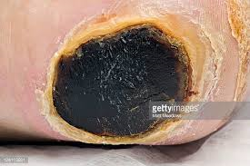
Black Necrotic Tissue:
Aims of treatment
  Does it need to be removed to allow healing to begin
  To reduce infection risk
  Facilitate healing

Slide 38
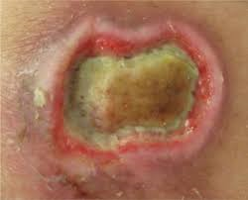

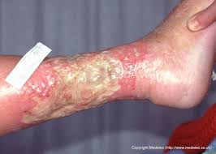
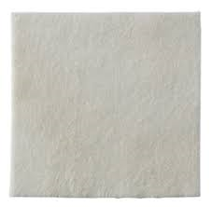
Yellow Sloughy Tissue:
Aims of treatment
Remove slough
  Allow granulation
  Reduce infection risk

Slide 39
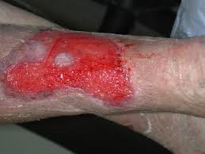
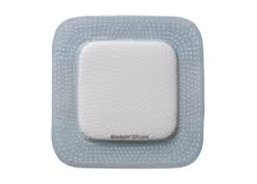
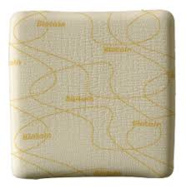
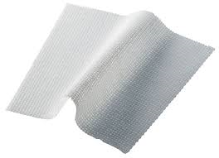
Red Granulation Tissue
Aims of Treatment
  Need to allow wound bed to fill with granulation tissue
  Tops of capillary loops visible
  Wound bed red and granular
  Need to maintain warm, moist, clean surface
  Avoid desiccation or maceration

Slide 40
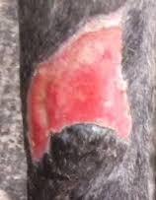

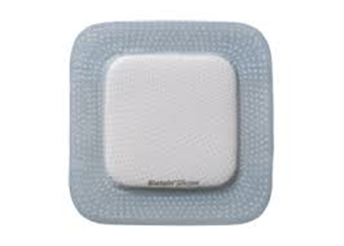

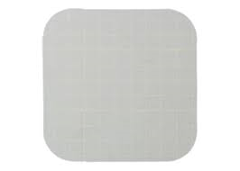
Pink Epithelialising:
Aims of treatment
  Protection
  Keep warm, moist and clean
  Try not to desiccate

Slide 41

Dressing selection
CONTACT LAYER To protection of healing wound tissue | ABSORBANT PAD To manage exudate | ANTIMICROBIAL Honey
ALGINATE/HYDROFIBRE Hydrophilic gelling fibre that manages exudate and debrides | FOAMS Manage exudate and create a healing environment | Iodine
HYDROGEL High water content, traps moisture within the product Debrides and hydrates | CHARCOAL DRESSINGS To manage odour | PHMB
HYDROFIBRE/PROTEASE MATRIX Alginate gel containing antimicrobial enzymes | HYDROCOLLOID Keeps the wound bed hydrated and protects vulnerable skin. | Silvers
MISCELLANEOUS Debridement pad Film Dressing Island dressing | BARRIER FILM/CREAM To protect the periwound skin | DACC

Slide 42
Hosiery Selection
British Standard Hosiery
RAL (European) Standard Hosiery
Class I | 14-17mmHg
Class II | 18 -24mmHg
Class III | 25- 35mmHg
Class I | 18 -21mmHg
Class II | 23 - 32mmHg
Class III | 34-46mmHg

Slide 43
How Can Pharmacists Support Wound Care?

Slide 44
Advice on simple wounds
Educate patients not to apply creams to wounds
Keep it SIMPLE
Advice on when to seek further intervention

Slide 45
Skin tear
A traumatic wound mainly occurring on the shin, hands and forearms of older adults
In neonates associated with tapes and adhesives
Friction and or shearing force which separate the epidermis from the dermis (partial thickness) or
Separate both epidermis and dermis from underlying structures

Slide 46
Assessment
Anatomical location and duration
Dimensions
Type and amount of exudate
Presence of bleeding or hematoma
Degree of flap necrosis
Integrity of surrounding skin
Signs and symptoms of infection
Associated pain

Slide 47
Management
Control bleeding
Clean the wound and gently pat dry surrounding skin
Preserve the skin flap if possible and reapproximate the edges where possible without stretching
Select an appropriate dressing such as Biatain Silicone Lite
Mark with an arrow and date to show direction of removal
Minimal disturbance
Manage pain

Slide 48
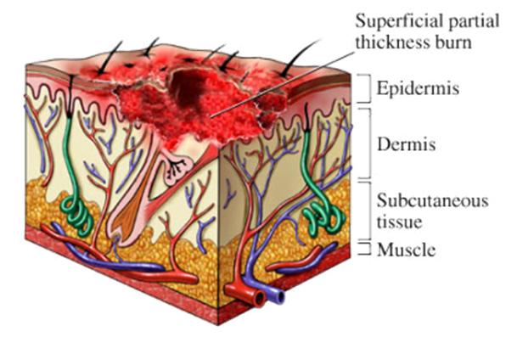
Burns
Epidermal burn: skin erythema, intact skin, e.g. sunburn.
Superficial partial thickness burn: involve epidermis and part of the papillary dermis.

Slide 49
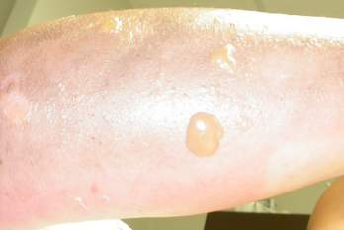
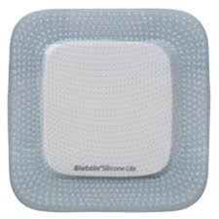
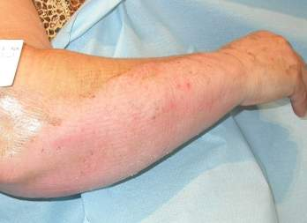
Management of Superficial partial thickness
Erythematous, bright pink or red
Thin-walled blisters
Extremely painful
Moist, almost weeping surface
Moderate oedema
Spontaneous healing (14-21 days)
Notes:
Superficial partial-thickness burns extend through the epidermis downward into the papillary, or superficial, layer of the dermis.
Blistering wounds that blanch with pressure are characteristic of superficial partial-thickness burns. These wounds are also typically moist and weeping.
Thin-walled, fluid-filled blisters will develop within minutes of the injury. As these blisters break, the exposed nerve endings transmit the senses of superficial pain, light touch, and temperature, making these wounds extremely painful.
The wound will be moist because the characteristic waterproofing of the epidermis has been lost, allowing body fluid to leak on the wound surface.
Due to dermal vascular network involvement in this type of injury, moderate edema is usually present. Infection may convert it to full thickness
The patient should be educated that skin may peel and that scarring will be limited to skin that is discoloured. Complete healing of superficial burns occurs within 7-20 days.

Slide 50
Pain
Superficial burns generally more painful
Exposed nerve endings are sensitive to cool, moving air
Choice of dressing extremely important for prevention of pain during and after dressing change
Full-thickness burns are associated with deep pain & pain in the surrounding areas
Fear & anxiety increase perception of pain
Notes:
Psychologic approach
Prevention of dressing change pain
Prevention of post dressing pain
Use of adapted dressings

Slide 51
Questions?

Slide 52
References:
Baker, E.A. & Leaper, D.J.(2000) Proteinases, their inhibitors and cytokine profiles in acute wound fluid. Wound repair and Regeneration. 8 (5) : 392-398.
Benbow M (2005) Evidence Based wound management. London , United Kingdom : Whurr.
Collier M (2002) Wound management Preparation. Nursing Times. 98 (2) NT Plus. Wound care suppl.
Dealy C (2005) The Care of Wounds. A Guide for Nurses. (3rd ed.) Oxford , United Kingdom :Blackwell.
Driscoll P (2010) Advanced Medical Technologies. Factor that affect Wound Healing . "Worldwide Wound Management, 2008-2017", Report S247
Flanagan, M. (2000) The physiology of wound healing. Journal of wound care. 9, 6.
Gray D & Bale S (2006) A pocket Guide to Clinical decision making in wound management. Aberdeen, Scotland:Wounds UK.
Hess, C. (2011) Checklist for factors affecting wound healing. Advances in skin and wound care. 24,4. page 192
Keast D.H. & Orsted H.L (1998) : The basic principles of wound care. Ostomy/Wound Management. 44, 8.Pg 24-8, 30-1)

Slide 53
Nguyen, D.T., Orgill D.P., Murphy G.F. (2009). Chapter 4: The Pathophysiologic Basis for Wound Healing and Cutaneous Regeneration. Biomaterials For Treating Skin Loss. Woodhead Publishing (UK/Europe) & CRC Press (US), Cambridge/Boca Raton, p. 25-57.
Stadelmann, WK; Digenis, AG; Tobin, GR (1998). "Physiology and healing dynamics of chronic cutaneous wounds.". American journal of surgery 176 (2A Suppl): 26S–38S.
Phillips,T.J. Al Amoudi, H.O. Levekaus,M. &Park, H.Y. (1998) Effect of chronic wound fluid on fibroblasts. Journal of wound care. 7, (10) 527-32
Timmons J (2006) Third line therapies. Wounds UK. Wound Care E Newsletter. July.
Tortora GJ & Derrickson, B.H. (2011) Principles of Anatomy and Physiology. (13th ed) New York, United States of America : John Wiley & Sons.
Waldrop & Doughty (2000) Wound Healing Physiology. Cited in Bryant R (ed) Acute and Chronic Wounds. Nursing Management.(2nd ed.) St Louis, United States of America : Mosby.
Winter, G.D. (1962) Formation of the scab and the rate of epithelisation of superficial wounds in the skin of the domestic pig. Nature. 193. 293-4

