Slide 1
Accessing e-LFH via CPPE
This guide will walk you through the steps to become registered with e-LFH
It has been tested, however you do need to follow the steps methodically

Slide 2
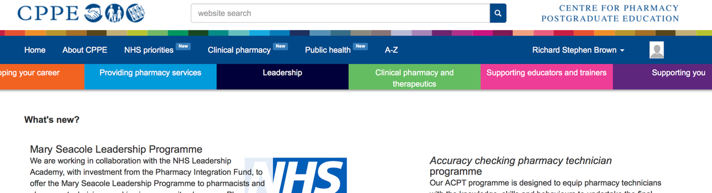
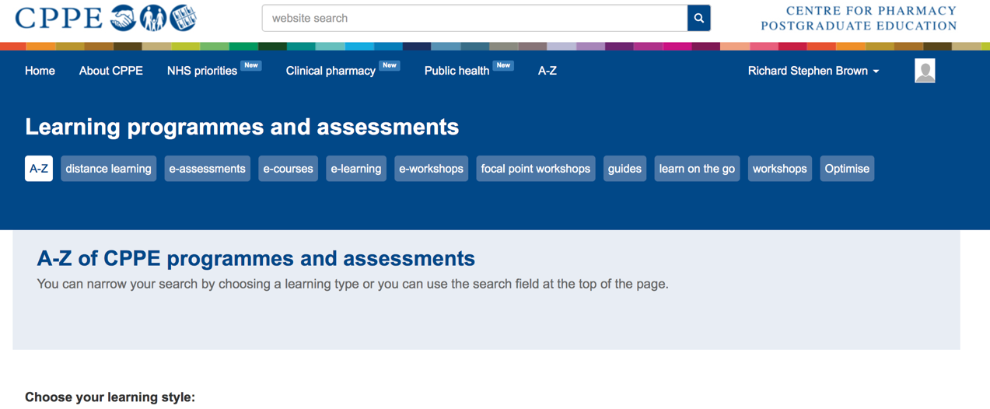
Select A-Z Courses
Select e-Learning
Select the module – e-Learning for Healthcare Learning modules

Slide 3
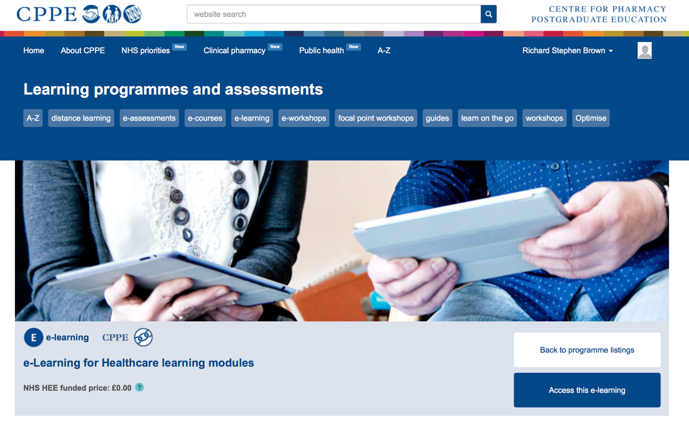
Click “Access this e-Learning

Slide 4
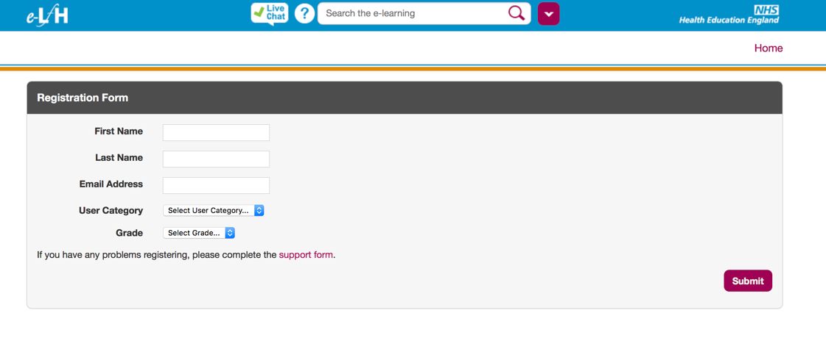
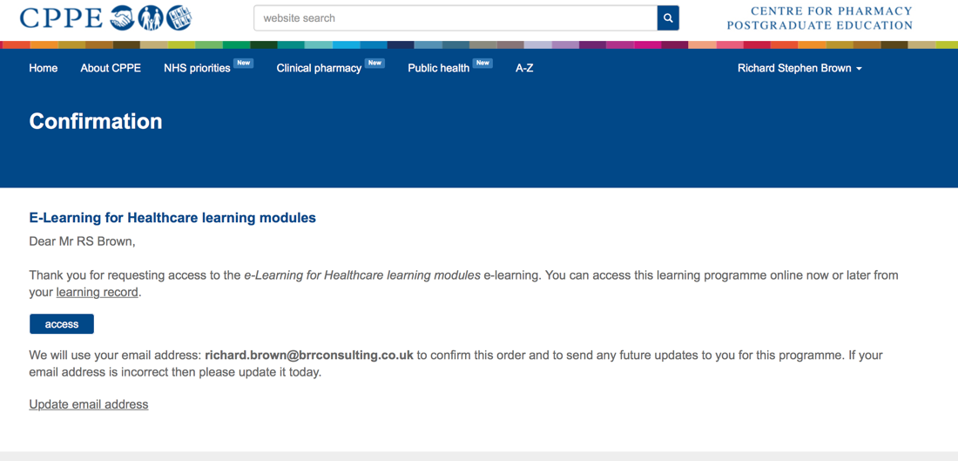
Enter your details on the e-LFH website
  Select Pharmacist as User Category
Click Submit
On CPPE - Click Access

Slide 5
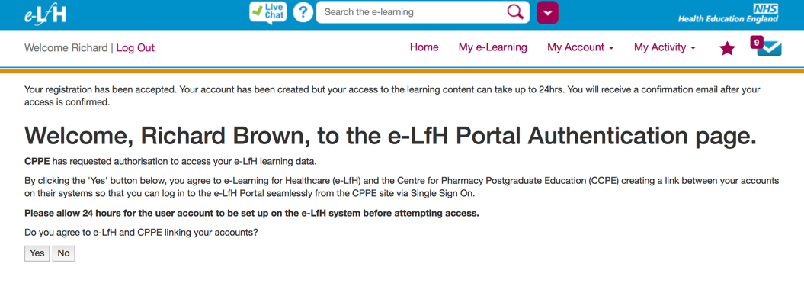
Select whether you agree to linking accounts

Slide 6
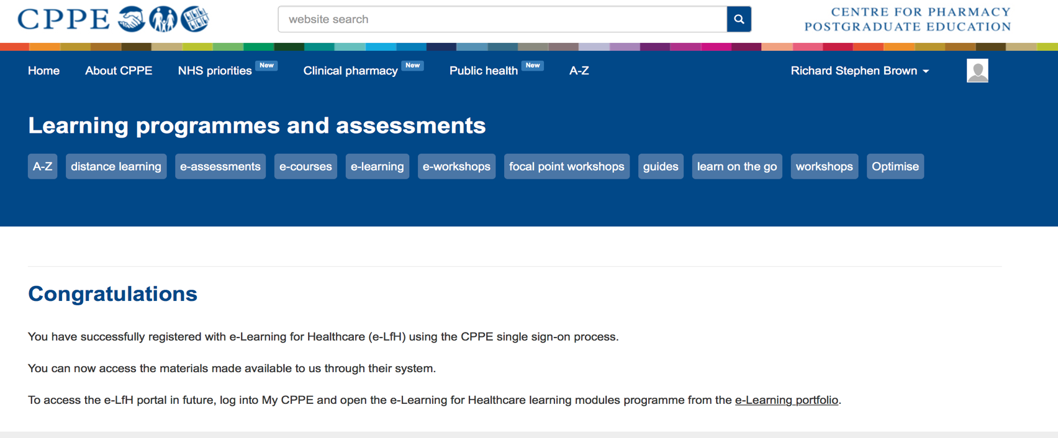

Slide 7
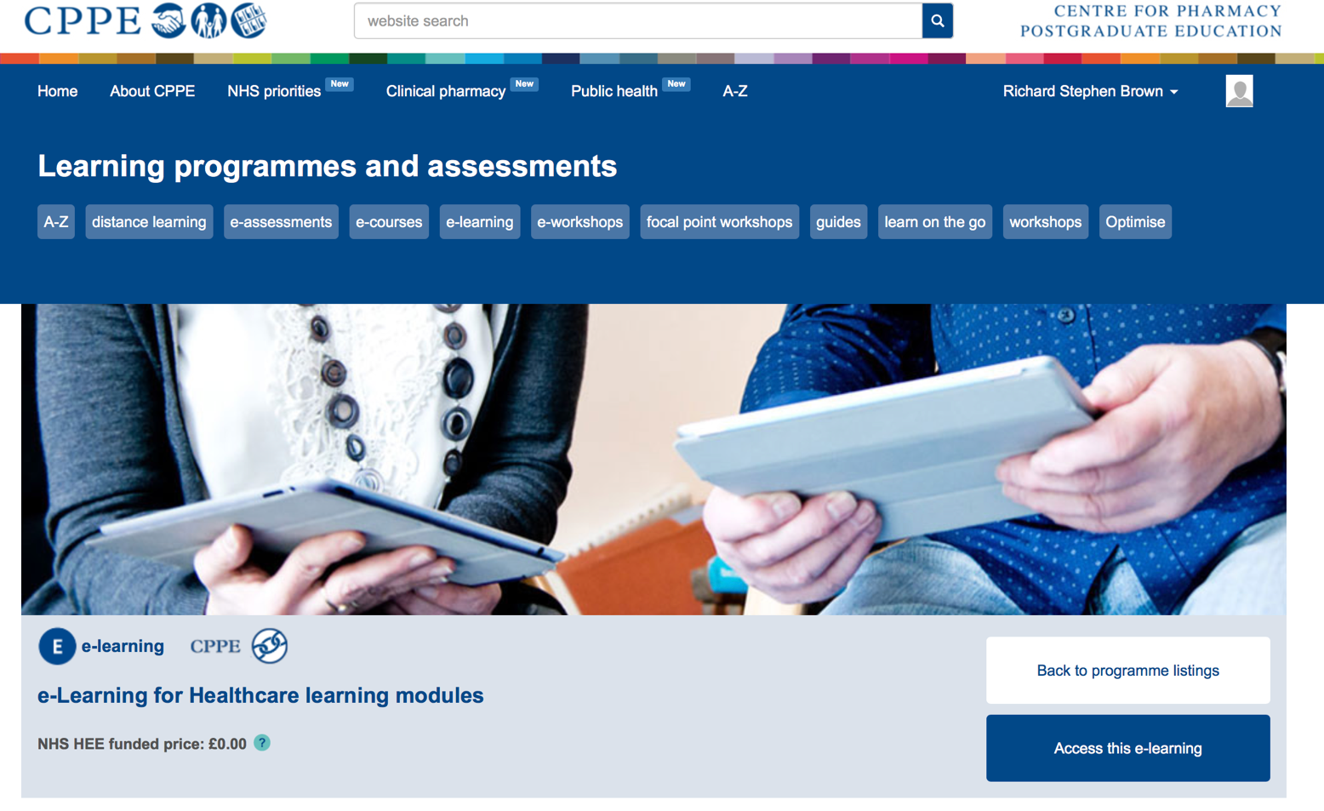

Slide 8
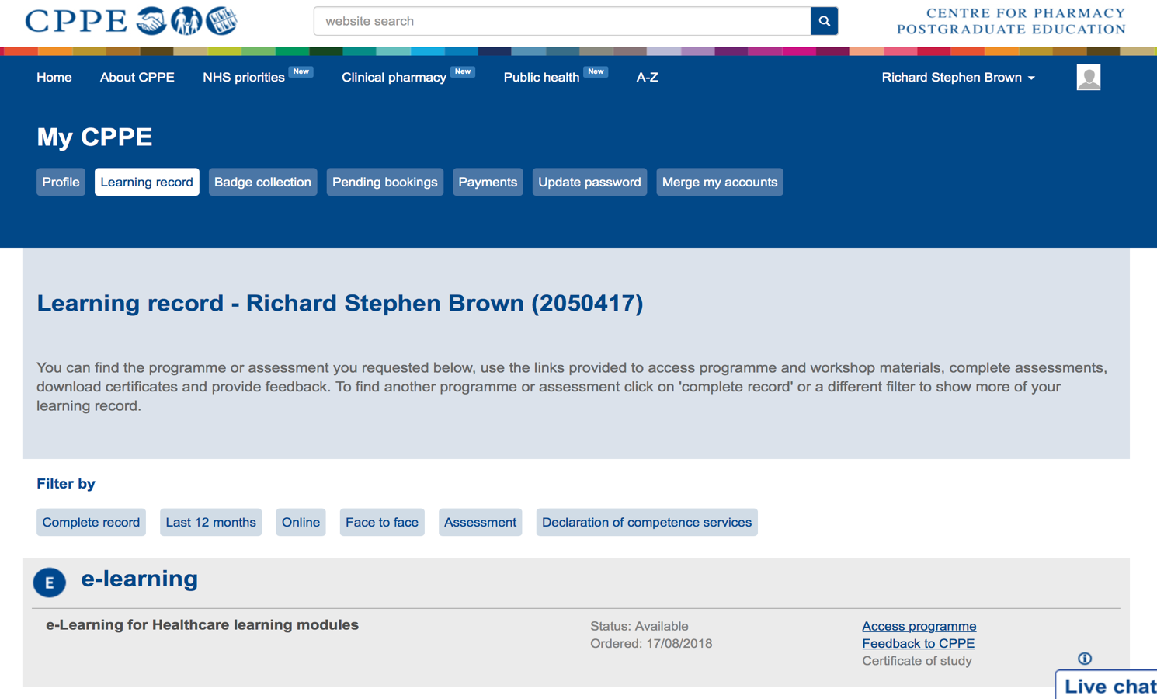
Select Access Programme

Slide 9
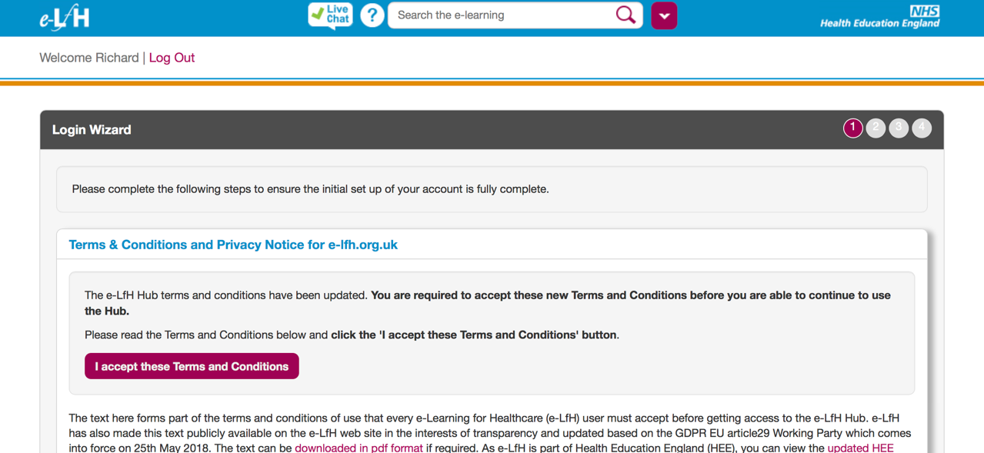

Slide 10
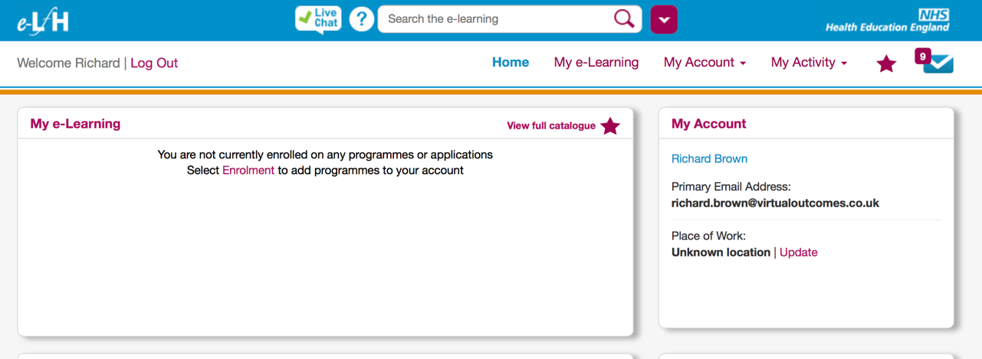
Select View Full Catalogue

Slide 11
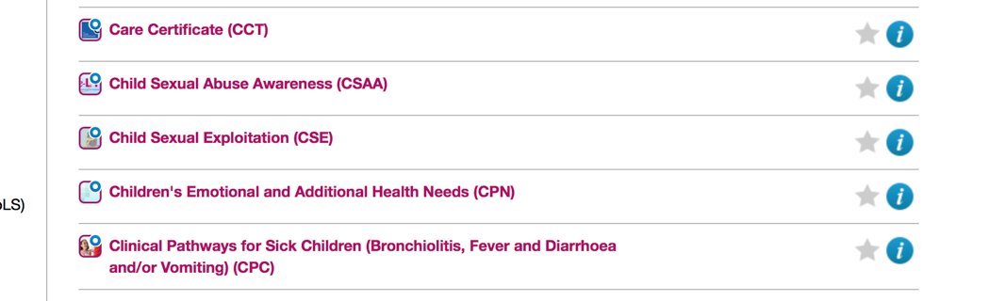
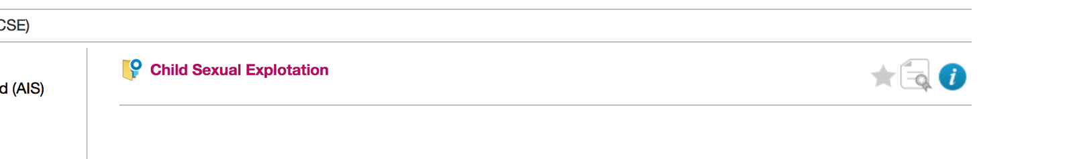
Select the “Child Sexual Exploitation” Module
Complete the module

Slide 12
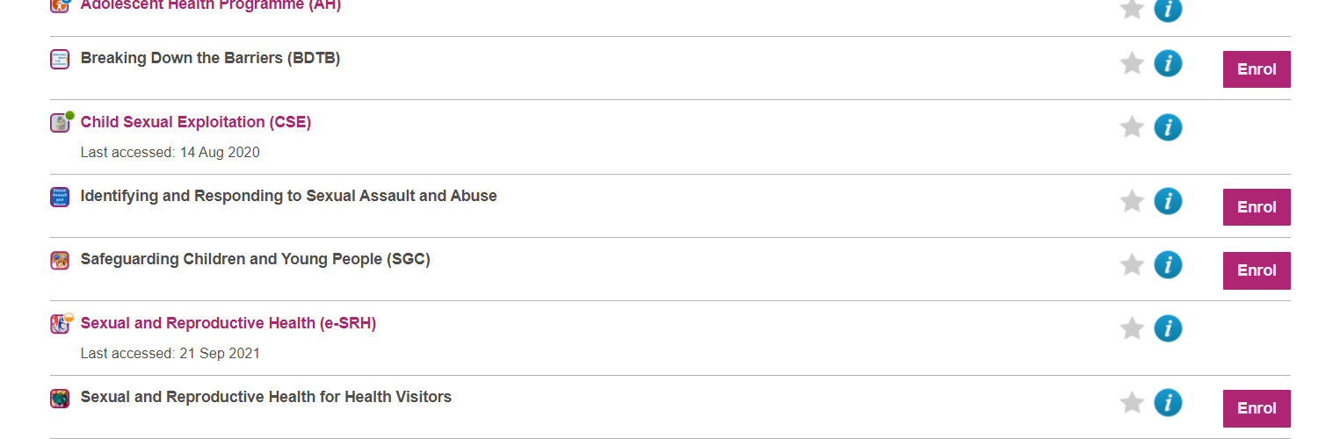
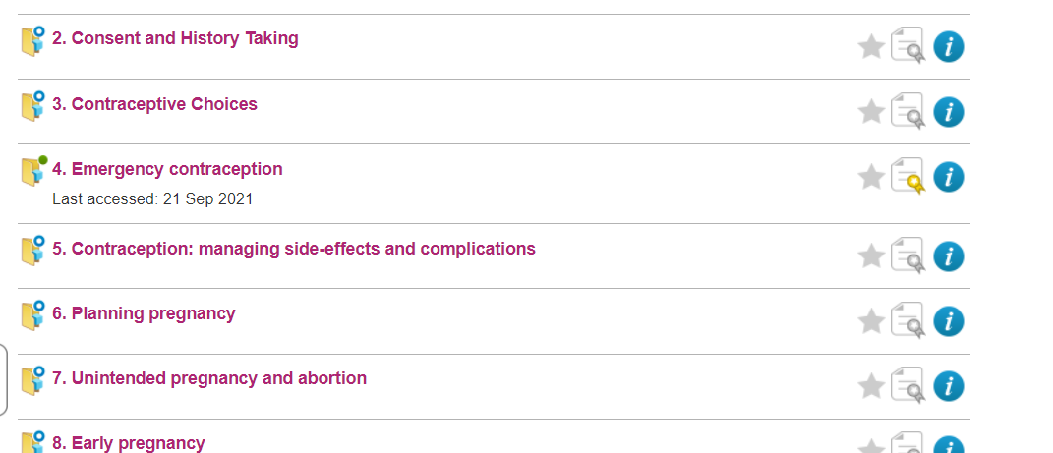
Select the “Sexual & Reproductive Healthcare” Module
The required module is number 4
  E-SRH 04 – Emergency Contraception
The new service specification goes live on the 1st March 2022.
When you log on you will be required to complete the new Declaration of Competence on PharmOutcomes

