Slide 1

The sexual health service in Bristol, North Somerset and South Gloucestershire (BNSSG)
Signposting information for Pharmacists and Pharmacy Technicians in BNSSG
When providing the NHS Pharmacy Contraception Service (including oral EC), the national service specification outlines how consultations in pharmacies should include signposting to other services when relevant for sexual and reproductive health.
Aug 2026, v1.0

Slide 2
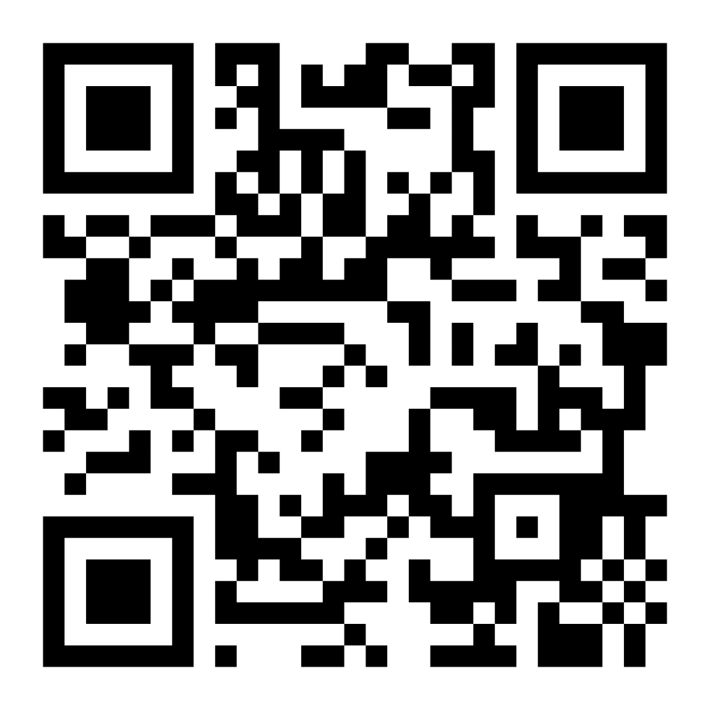
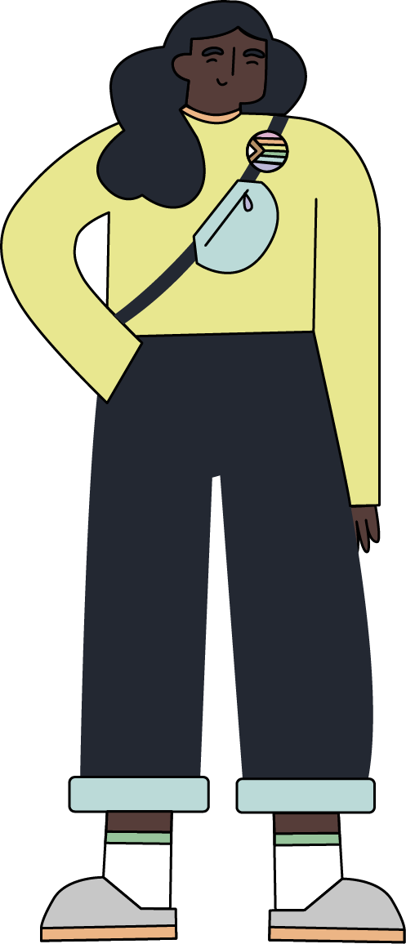
Keep up to date with Yuno Sexual Health
Scan the QR code to visit the Yuno Sexual Health website www.yunosexualhealth.co.uk
Professionals can sign up to the Yuno mailing list to receive updates about the service.
Follow Yuno on X (Twitter), Facebook and Instagram @‌yunosexualhealth

Slide 3


BNSSG Integrated Sexual Health Service
Yuno health promotion & outreach Brook & Brigstowe
Health promotion, prevention and outreach with at risk populations
Digital comms, PR and marketing – campaigns and healthy sex messaging
Co-developed community engagement
Outreach to vulnerable groups
Condom distribution scheme
Supporting schools with RSE
Lead for Yuno patient & public engagement
Training for professionals
HIV prevention and support for people living with HIV, including addressing stigma
Yuno digital SH:24
Clinically supported website for self-service
Advice and information
STI/HIV testing (no symptoms or mild)
STI treatment (chlamydia, herpes and warts)
Partner notification
Condoms
Emergency hormonal contraception
Bacterial vaginosis and thrush treatment
PrEP (HIV prevention)
DoxyPEP (syphilis prevention)
Photodiagnosis: herpes, warts and other lumps
Signposting and clinic appointment booking
Safeguarding
Yuno clinical UHBW & Brook
Face-to-face, telephone and walk-in clinic appointments across BNSSG
Symptomatic STI testing and treatment
HIV testing
Vaccinations (Hep A & B, HPV, Mpox, gonorrhoea)
Contraception including post birth contraception
PrEP (for HIV prevention)
DoxyPEP (syphilis prevention)
Domestic and sexual violence screening
Safeguarding
Clinical advice
Clinical outreach supporting health promotion service
Training for clinicians
Lead for Yuno clinical governance
  Working with African and Caribbean heritage communities to address HIV & sexual health
Yuno works closely with:
Abortion care services UHBW/NBT/MSI
Advice and support
Medical abortions
Surgical abortions
STI/HIV testing
Post abortion contraception provision
HIV treatment service NBT
Other services VCSE & LA
Drug & alcohol
Homeless health
Migrant health
Sex worker support
Sexual assault (SARC)
Domestic and sexual abuse
Child sexual exploitation (CSE)
Welfare support
Social care
Housing
Mental health
Safeguarding
Primary care sexual health services
GPs & Pharmacies
Contraception (GPs/some Pharmacies) including coil and implant fits (GPs only)
Emergency hormonal contraception
Some STI and HIV testing and treatment
Other hospital departments
NBT/UHBW
Maternity
Gynaecology
Urology
Dermatology

Slide 4

Yuno phonelines for professionals and service users
For professionals only For urgent clinical advice (this is not a patient advice line) phone Yuno on the professional helpline: 0117 342 6913
Please note: The professional helpline is currently managed by the Yuno at Central Health Clinic (Bristol). The helpline opening hours will match Yuno Central Health clinic opening hours found at: www.yunosexualhealth.co.uk
Yuno phonelines for service users
Yuno central phone number: 0117 342 6900
Yuno at WISH, Weston (all age clinic in North Somerset) phone number: 01934 881 234
Yuno Brook Bristol Clinic (under 25s clinic) phone number: 01179 290 090

Slide 5
Emergency copper coil (Cu-IUD)
It needs to be fitted by a doctor or a nurse with specialist training.
If it is fitted within 5 days after unprotected sex, or within 5 days of a person’s earliest predicted date of ovulation, then it’s over 99% effective at preventing pregnancy and the most effective emergency contraception.
It can be left in place to provide ongoing non-hormonal contraception.
It is important to make an urgent appointment at a Yuno clinic.
Find a clinic using the Yuno website.
Patient can contact their GP to ask if an appointment is available for an emergency coil. (Some GPs might not have an emergency coil service available)
Yuno
GP Practices (for registered patients)
If more than 5 days have passed since unprotected sex, it is advisable they still seek advice immediately by contacting Yuno or contact their GP.

Slide 6

Emergency Contraceptive Pill – available for free
In addition to pharmacies, the emergency contraceptive pill is also available from:
Under 25s can fill in an online consultation to be prescribed the emergency hormonal contraceptive pill. As this pill must be taken within a specific timeframe, service users may be advised to access the pill elsewhere if there isn't enough time for processing and delivery.
Find a clinic using the Yuno website.
Yuno website: free for under 25s
Yuno clinics: free for all ages
GP Practices (for registered patients)
Bristol Urgent Treatment Centre

Slide 7

Contraception (including coils and implants)
Yuno offers all forms of contraception, including coils and implants (LARC)
People can choose to have their LARC fitted at a Yuno clinic
Yuno require a referral from a GP for coil fitting appointments (a self-referral pathway is under development).
Yuno accept self-referrals for implants: make an appointment at a Yuno clinic.
More information is available about different types of contraception methods on the Yuno website
GP surgeries can prescribe contraception and give advice on contraceptive methods.
Most GPs offer fitting of long-acting reversible contraception (LARC) like the coil or implant.
Yuno
GP Practices (for registered patients)

Slide 8
Contraception for transgender and non-binary people
This statement from the CoSRH (The College of Sexual & Reproductive Healthcare) provides information on emergency contraception and contraceptive choices for transgender and non-binary people and their partners, who are engaging in vaginal sex where there is a possibility of pregnancy:
Weblink: CoSRH statement: Contraceptive Choices and Sexual Health for Transgender and Non-Binary People (2017)

Slide 9
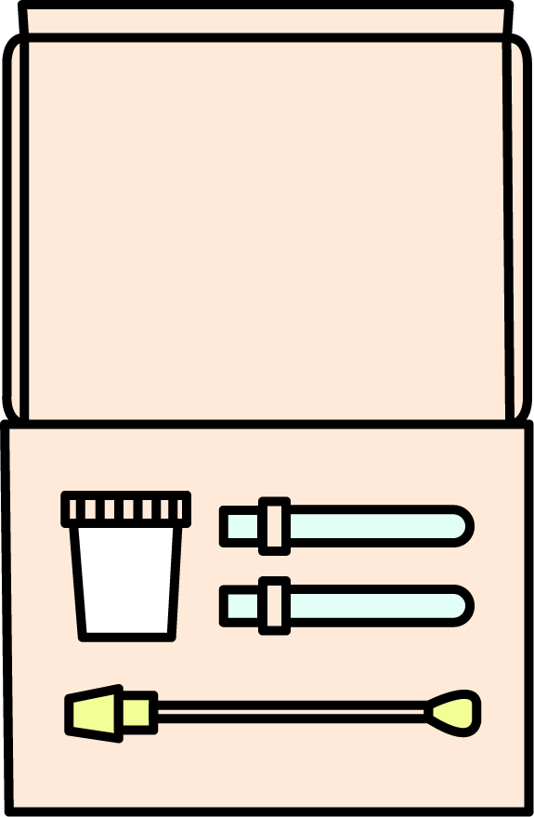
Testing for Sexually Transmitted Infections (STIs)
No STI symptoms and over age 16?
Order a home test kit online from the Yuno website
Previous Vending Machine option is currently unavailable – update to follow.
Please note, an online option for under 16s to order home test kits is being explored.
Arrange an appointment for STI testing at a Yuno clinic
For opening hours and the clinic details check the Yuno website
Please check Yuno website for most up to date information about choice of clinics, opening hours and if any walk-in options are available or if appointments only.
STI Symptoms? OR under age 16?
Age 24 and under, Yuno at Brook Bristol clinic
People can ask their GP practice if STI testing is available

Slide 10

Free Condoms
Yuno website: for age 16 - 24
Young people aged 16 – 24 in BNSSG can order free condoms online using the Yuno website and the condoms are delivered by post. (an online option for ages 13 – 16 is being explored).
When ordering an STI test kit, service users aged 16 - 24 will be offered the option to add free condoms to their order.
Young people aged 13 – 24 can pick up free condoms in the community across BNSSG at participating organisations who are outlets for the BNSSG Condom Distribution Scheme. This includes in all secondary schools (via school health nurse) and places such as youth clubs.
If you have questions about the Condom Distribution Scheme email: yuno@brook.org.uk
Young people and adults can pick up free condoms at a Yuno clinic.
Find a clinic using the Yuno website.
Condom Distribution Scheme: for age 13-24
Yuno Clinics

Slide 11



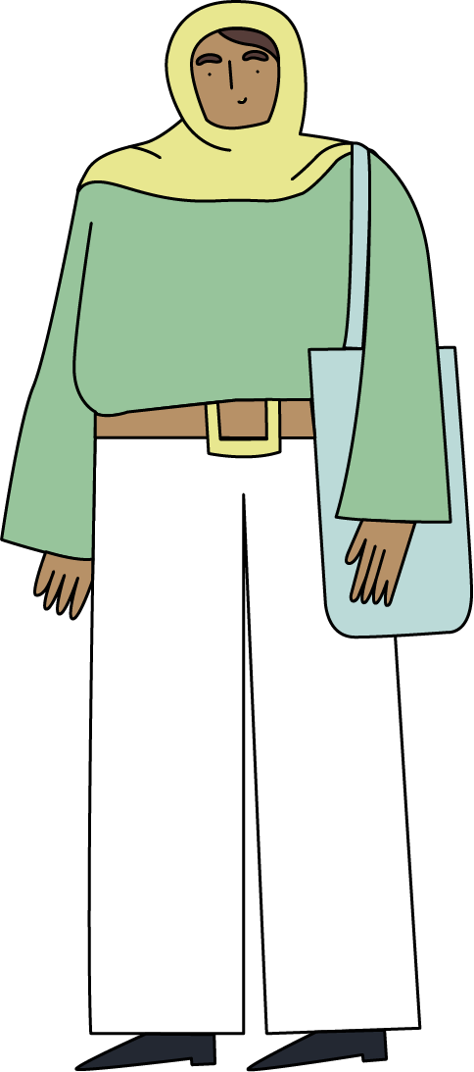
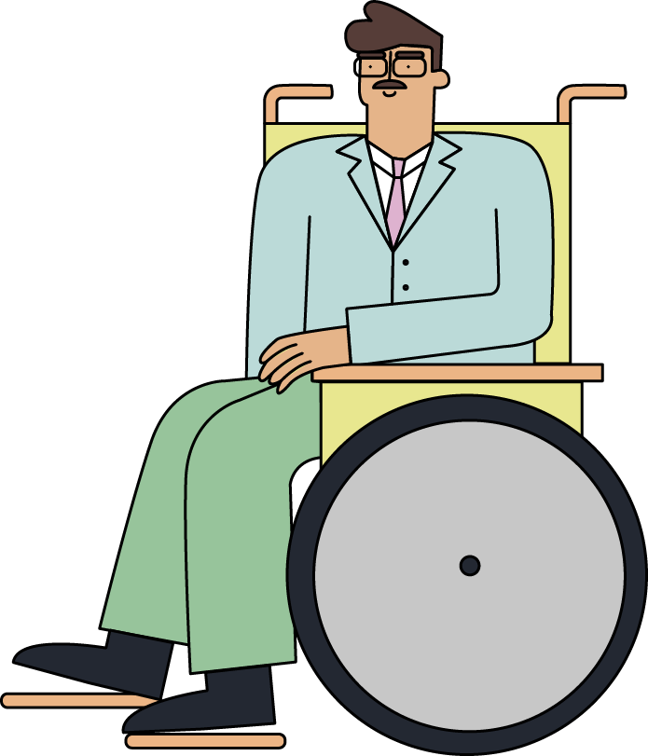
Sexual Health Clinics in BNSSG
Find a clinic using the
Yuno website
​
People of all ages, genders and sexualities are welcome at Yuno
For young people: under 25s Yuno at Brook Bristol clinic
For opening hours and the clinic details check the Yuno website.
Please check Yuno website for most up to date information about choice of clinics, opening hours and if any walk-in options are available or if appointments only.

Slide 12

Yuno community services (walk-in) for BNSSG
In addition to Yuno clinics, sexual health care is also available through Yuno community partners. Please check Yuno website for most up to date information.
CAB run clinics (for age 18+) for people of African and Caribbean Heritage only
Check the Common Ambition webpage for details of clinics and opening hours.
These walk-in CAB clinics offer testing for HIV, syphilis, chlamydia and gonorrhoea. Free condoms are available and PrEP (which prevents HIV).
Brigstowe run a non-clinical walk-in service (for age 18+) for advice, testing for chlamydia, gonorrhoea, HIV, Syphilis and Hepatitis B & C, and free condoms.
A Yuno outreach professional helps facilitate user-activated test kits.
For details of choice of testing drop-ins and opening hours check the Yuno website.
Common Ambition Bristol (CAB)
Brigstowe testing drop-ins

Slide 13


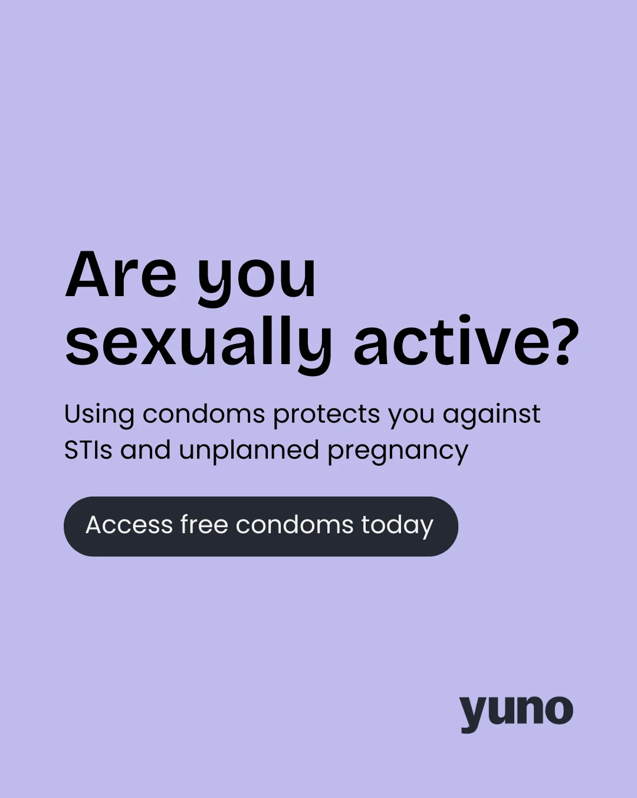

The Yuno Professional Zone webpage has helpful information for professionals. This includes details about training available for professionals working in BNSSG.
Here is the Yuno comms toolkit for your reference and use.
It is a Trello board featuring assets and wording you can use to help promote Yuno across Bristol, North Somerset and South Gloucestershire.

Slide 14
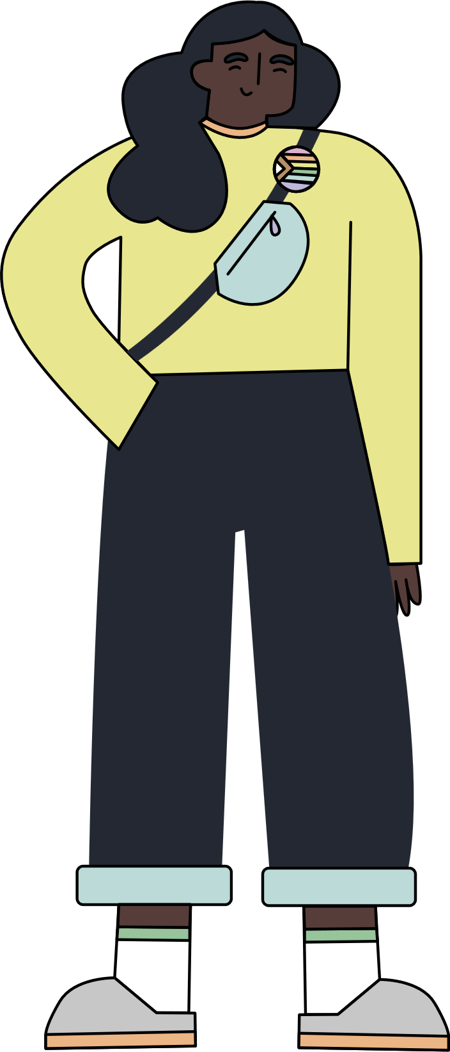
additional signposting information

Slide 15
Emergency PEP for HIV exposure
If a person thinks they've been exposed to HIV, PEP (post-exposure prophylaxis) is an emergency medication that can prevent the infection if taken within 72 hours of unprotected sex.
They need to contact Yuno as soon as possible, they may be given PEP at a Yuno clinic or outside of opening hours, at a nearest A+E.
Yuno provides support and guidance here:
I think I've been exposed to HIV

Slide 16
PrEP HIV Prevention
PrEP is a pill that can be used to prevent HIV. Find out more on the Yuno website.
PrEP is a free NHS treatment
In BNSSG, PrEP is available for people to order through the Yuno website and in Yuno clinics
Yuno online PrEP service (for age 18+): Service users will need to complete an online consultation to determine if they can receive PrEP online, which will be reviewed by a clinician from the Yuno online service.
Yuno clinic: Service users can make a PrEP appointment at their nearest Yuno clinic.
Yuno provide advice on using PrEP safely and service users may be able to receive regular PrEP monitoring, including STI screens, HIV and kidney function tests through the website.
If a person is buying PrEP online it is important they know it is available for free via Yuno and that Yuno also provide support touse treatment safely.

Slide 17
Genital lumps, bumps and ulcers
If a person has concerns about any genital lumps, bumps and ulcers - it is important they seek clinical advice as this could be symptoms of genital warts or herpes which require treatment.
Online photo-diagnosis: People age 18+ can confidentially upload photos of their symptoms for a clinician from the Yuno online service to review, who can then diagnose and advise on the right treatment. If treatment at home is not suitable or remote diagnosis isn't possible, they will refer a service user to a local clinic and give advice on managing symptoms.
Find a clinic using the Yuno website to make an appointment to be seen in person.
People can contact their GP to ask for an appointment to discuss symptoms.
Yuno website: 18+ only
Yuno Clinics
GP Practices (for registered patients)

Slide 18
Unusual vaginal discharge
If a person has concerns about vaginal discharge - it is important they seek clinical advice.
Yuno website: 18+ only
Online consultation and treatment: Service users are taken through an online consultation which aims to determine whether they have bacterial vaginosis or thrush. Service users may be offered treatment, and if the symptoms do not stop they will be directed to book an appointment at a local clinic.
Find a clinic using the Yuno website.
Unusual discharge may mean the patient has thrush. Service users can get treatment from a pharmacy for thrush. The pharmacy can check eligibility for free treatment.
People can contact their GP to ask for an appointment to discuss symptoms.
Yuno Clinics
Pharmacy
GP Practices (for registered patients)

Slide 19


Post-birth contraception in BNSSG
Southmead Hospital (North Bristol NHS Trust) and St Michael’s Hospital (University Hospitals Bristol and Weston NHS Foundation Trust) are now offering post-birth contraception.
This service offers those who are pregnant the opportunity to create a plan for receiving contraception after they give birth whilst they are still in hospital.
To help people create a personalised post-birth contraceptive plan, the service offers advice sessions with specialist contraception nurses, midwives, and other healthcare professionals, as well as educational resources.
Visit the North Bristol NHS Trust and University Hospitals Bristol and Weston NHS Foundation Trust websites to find out more.

Slide 20
Pregnancy Testing
For a reliable negative result - do a pregnancy test if the unprotected sex was more than 3 weeks ago or if
period is more than 7 days late.
People can buy pregnancy test kits online or from supermarkets and pharmacies.
If someone needs help to do a pregnancy test:
Contact a Yuno clinic: call 0117 342 6900 or find a Yuno clinic
Under 25s can contact Brook: call 01179 290 090
A person might still be able to have an Emergency Copper Coil (also known as a copper intrauterine device,
Cu-IUD) fitted to prevent pregnancy depending on their circumstances. They will need to immediately contact
their GP or call Yuno to discuss.
The Yuno service website provides Pregnancy Testing Information and Support

Slide 21

Pregnancy Advisory Service in BNSSG
UHBW works in partnership with MSI UK Reproductive Choices to provide this service.
If a person has a positive pregnancy test, information is available from the local NHS free Pregnancy Advisory
Service about pregnancy options and support available. This includes information and advice about abortion.
For advice about pregnancy options – contact the Pregnancy Advisory Service:
Book a free, confidential conversation about pregnancy options with a health professional at the Pregnancy Advisory Service on 0345 872 5435 (7am-8pm daily). The consultation will usually be over the phone.
Or a person can book a telephone consultation online (this will take them to MSI UK)
The Brook website provides advice and information about pregnancy and thinking about pregnancy options.

Slide 22


Assault and Sexual Violence – signposting information
If a person needs any support due to experiencing any kind of violence or abuse, the Yuno website provides signposting information to the range of services available.
Assault and Sexual Violence Information and Support | Yuno
If a person has been raped or sexually assaulted, The Survivor Pathway South West Sexual Violence Support Services online guide provides information about the pathways to services for children, young people and adults in Bristol, North Somerset and South Gloucestershire (BNSSG).
The Survivor Pathway
The Bridge is the local Sexual Assault Referral Centre (SARC) for BNSSG for help after rape and sexual assault.
Available 24/7, call the Bridge: Phone: 0117 342 6999
Professionals can make a referral

